Slide 1
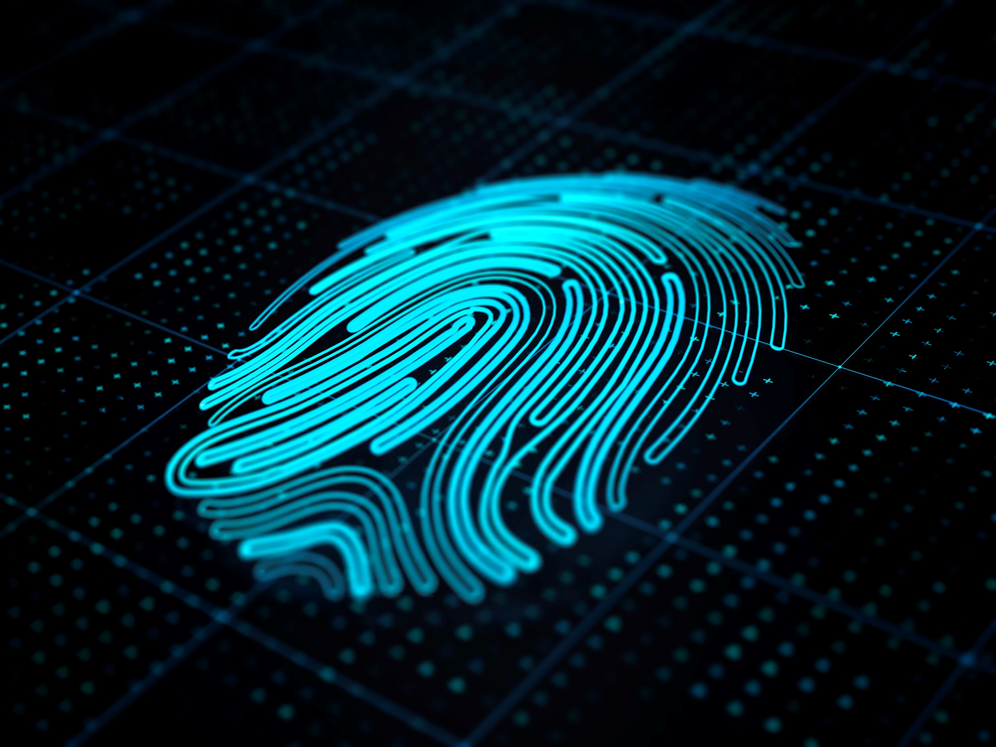
Welcome
HPE Server Security

Slide 2
Cyber crime
James Morrison
Notes:
Claim: The World’s Most Secure Industry Standard Servers¹
Substantiation: ¹ Based on external firm conducting cyber security penetration testing of a range of server products from a range of manufacturers, May 2017.

Slide 3

Cyber security requires a more holistic approach
Data is the new currency
Loss of function is the new weapon
With many intelligent devices independently processing,
data and control must be secured at every point
Protect
new vulnerabilities
Detect
intruders fast
Recover
quickly from an attack
Source: 2018, Gartner, Inc

Slide 4

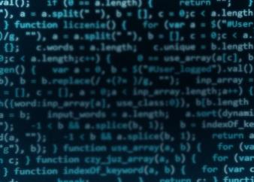

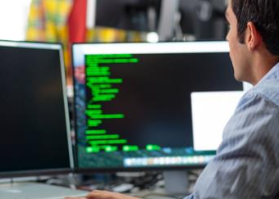
Today’s reality
Change brings new challenges
Enterprise IT
will continue to transform
The adversary
is innovating
Business depends
on security
Regulations
Complexity & costs are rising
Skills
Scarcity is a top challenge
Notes:
James
To effectively protect your digital enterprise, we need to accept a new normal.
Enterprise IT and the digital ecosystem of each company will continue to rapidly transform through innovation, and with each step there are new attack surfaces and vulnerabilities
The adversary looking to exploit these attack surfaces is getting far more sophisticated and is constantly innovating as well. These attackers range from script kiddies to criminal organizations to nation state actors, all with different motivations and capabilities.
In this reality, we have to assume compromise.
Add to this a rapidly evolving regulatory environment, and a lack of security skills which will not be solved for in our generation, doing even the simple stuff is still a challenge. (talk about basic hygiene challenges) The #1 vulnerability exploited last year was the same one exploited the year before, and had a patch available 4 years back. Implementing robust access controls is still daunting. And keeping track of, classifying and securing your data continues to be a challenge now many years running.

Slide 5
Global cyber Crime Damages, 2001-2018
Amount of monetary damage caused by reported cyber crime to the IC3 from 2001 to 2018 (in million U.S. dollars)
Sources: FBI; IC3; US Department of Justice

Slide 6


$13.0m
Mean annualized cost of a cyber crime incident¹
2019 Ponemon Cost of Cybercrime study
3.7%
GDPR requires breach notification within
of IT budget spent on security²
72hours
PWC Global state of information security survey report 2017
56%
of executives say their response to security is reactive not proactive³
3. 2014 Ponemon report on senior executive response to security
Notes:
Simon
Highlight the Stats.

Slide 7


78
Average time cyber criminals are inside before detection¹
^{days}
M-Trends 2018: 101 days
M-Trends 2017: 99 days
M-Trends 2016: 146 days
M-Trends 2015: 205 days
M-Trends 2014: 229 days
2019 …August September October November…
Mandiant M-Trends 2019
Since 2010, time to resolve an attack has grown³
52%
of breaches involve hacking²
3.5x
2019 Verizon Data Breach Investigations Report
Ponemon Cost of Cybercrime report 2010 & 2017
“As cyber attacks become more sophisticated, the potential for BIOS or other firmware attacks is growing”⁴
4. National Institute of Standards and Technology (NIST) Special Publication 800-147b, 2014, updated 2017
Notes:
Simon
Highlight the Stats.

Slide 8
Can the threat be mitigated through innovation?
Massive Change is underway
  Hyper-connected world
  Incredible data growth
  Hybrid IT the new “normal”
Cyber threats are everywhere
  We can’t eliminate the threat
  Firmware is now a target
  Supply chains are now a target
  Threat is from the outside – and – from within
What’s the answer?
  Can continued innovation mitigate the threat?

Slide 9

Allen Whipple
Gen10 Security Overview
Notes:
Claim: The World’s Most Secure Industry Standard Servers¹
Substantiation: ¹ Based on external firm conducting cyber security penetration testing of a range of server products from a range of manufacturers, May 2017.

Slide 10
?
are your customers TRULY protected

Slide 11
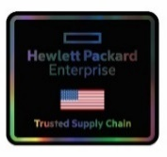
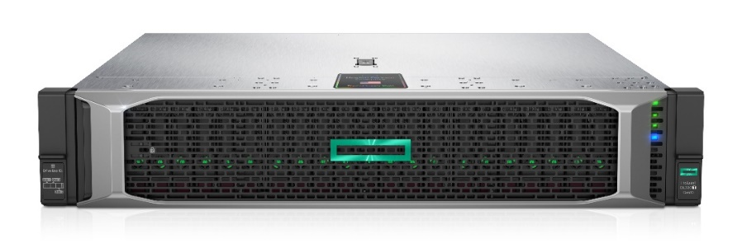
HPE Trusted supply chain
The new HPE ProLiant DL380T will ship with these five security features activated at the U.S. factory
Part number: P36394-B21
  HPE Trusted Supply Chain FIO Configuration
DL380T Platform
  More platforms on future roadmap
Available October 1, 2020
Made in USA at our Chippewa Falls, WI facility
Unique labeling
HPE Press Release
https://www.hpe.com/us/en/newsroom/press-release/2020/10/hewlett-packard-enterprise-becomes-the-only-major-server-manufacturer-to-ship-worlds-most-secure-industry-standard-made-in-usa-servers.html
HPE Blog
https://community.hpe.com/t5/servers-systems-the-right/hpe-extends-supply-chain-security-with-hpe-trusted-supply-chain/ba-p/7103167#.X3tIZWhKhPY
1
Placing servers in high security mode
The ProLiant DL380T will be placed into high security mode at the HPE factory in the US. This feature, invoked through iLO commands, actually reduces the attack surface for cyber attackers, making it more difficult to insert compromised code or malware into the server firmware.
Enabling the UEFI Secure Boot feature
For customers who ask HPE to load their operating system at the factory, another option is to enable the UEFI Secure Boot, which connects the HPE Silicon Root of Trust to the OS. An industry-recognized feature, affixing the UEFI firmware to the boot loader insures the genuine and authenticated OS is initialized.
HPE Server Configuration Lock
This feature, which is unique to and only offered by HPE, will create a log inside the server. If any firmware, hardware, or options are altered, registers an immediate alert at boot-up. Enabling this feature at the HPE factory essentially prevents any and all tampering or compromise to the server composition, no matter how slight.
The HPE Chassis Intrusion Detection device
This mechanism protects the ProLiant DL380T from physical intrusion. The Chassis Intrusion Detection Device registers an alert if the top of the server chassis is removed.
Specialized delivery services
These will actually provide a dedicated truck and driver, if requested, to deliver the DL380T safely right from the HPE factory to the end-user location. At an additional service, delivery options available to customers are the express service and the white glove service.
2
3
4
5

Slide 12
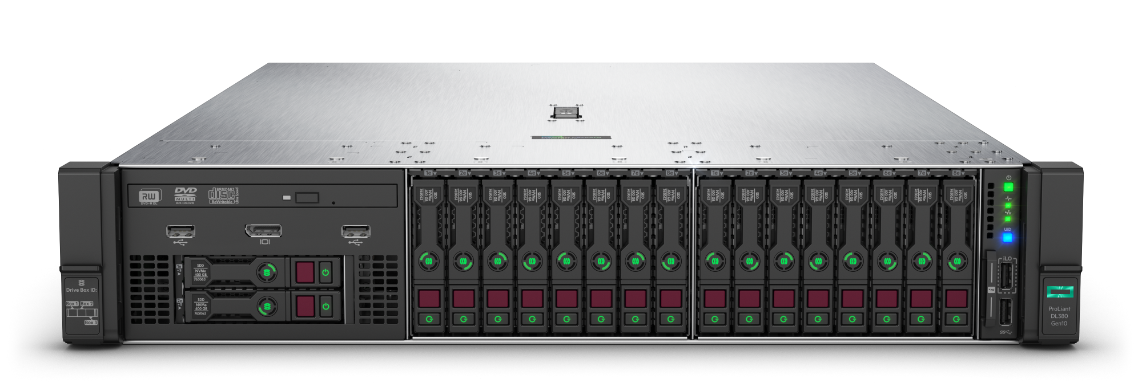
The worlds most secure industry standard server
HPE Gen10 Servers with iLO 5

Slide 13
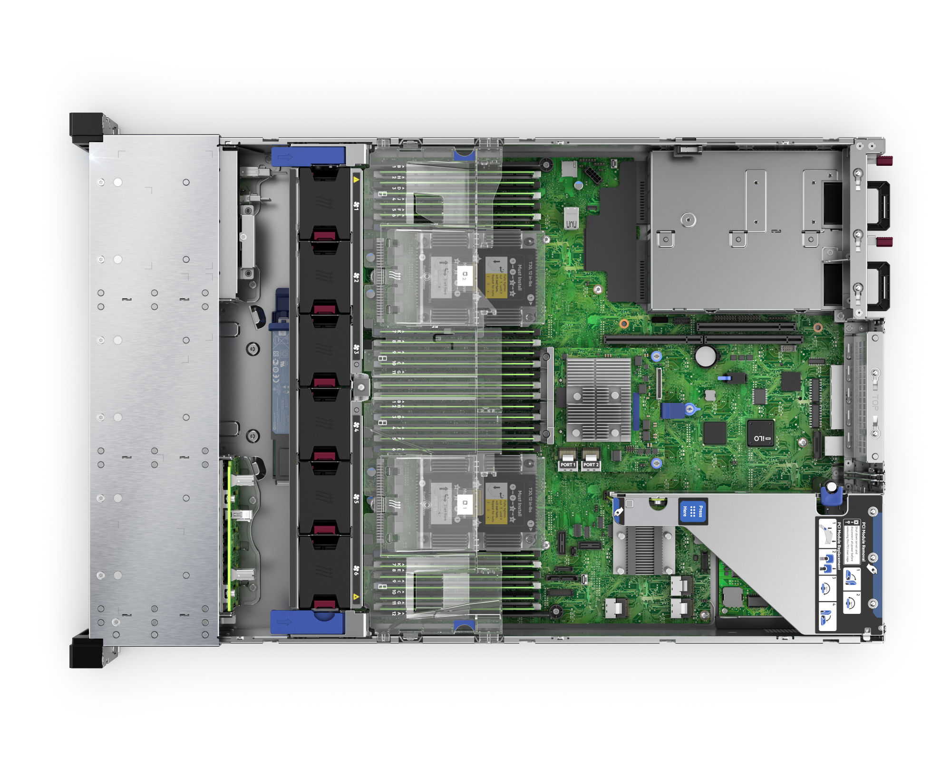
Ilo 5
The magic is in the iLO5 chip!
Our silicon, our firmware, our chip
Detect
  iLO5 chip
Protect
  Run-time detection
  Up to once every 24 hours
Recover
  Restore to last known good state
  Restore to factory settings
  Take server offline
You need iLO Advanced!!!
You need iLO Advanced!!!
You need iLO Advanced!!!

Slide 14

HPE Security unique differentiators
HPE Chassis Intrusion Detection Switch
Will detect any physical intrusion attempts and will log event. Audit events are logged even if there is no power to the system thus providing that ability to know if there were any attempts to open the lid during transit
Marsh Cyber Catalyst Designation
A cyber tech evaluation program by Marsh that identifies solutions that they consider effective in reducing cyber risk. Cyber Catalyst designations qualify for enhanced terms and conditions on individually negotiated cyber insurance policies from participating insurers.
HPE Server Configuration Lock
Server Configuration Lock protects systems in transit and when deployed in insecure locations such as retail stores, outdoor access points, IoT platforms and more. This ensures that customers’ systems shipped from one location to another are not vulnerable to attack in the supply chain.
HPE Silicon Root of Trust
Silicon Root of Trust anchors the BIOS and all other essential firmware of HPE ProLiant to an HPE-exclusive ASIC even before the server is built, creating an immutable fingerprint in the iLO silicon that must be exactly matched before the server will boot.
HPE Server System Restore
Server System Restore provides automated recovery from a security event, including restoration of validated firmware, and facilitating recovery of operating system, application and data connections. This provides a fast path to bring a server back online and into normal operations.
HPE One Button Secure Erase
One Button Secure Erase provides simple, safeguarded removal of passwords, configuration settings and data from a server being repurposed or retired, preventing inadvertent access to previously secured information.

Slide 15
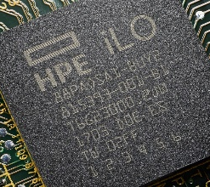
HPE Smart Buy Express iLO Advanced
iLO Advanced 1 year & 3 year physical license SKU’s are now available on the new FY20 Q4 SBE flyer
Average savings of 43% on HPE iLO Advanced SBE offerings
HPE iLO Advanced 1-svr Electronic License 1 year support
HPE iLO Advanced 1-svr Physical License 1 year support
HPE iLO Advanced 1-svr Physical License 3 year support
$229*
$227*
$270*
List Price $399
List Price $399
List Price $469
E6U59ABE
512485-B21
BD505A
43% SAVINGS
43% SAVINGS
42% SAVINGS
* Pricing show is expected savings & is subject to change. Contact your reseller or distributor for actual pricing.
Notes:
SBE FLYER Pricing
P02465-B21
P06453-B21
P04649-B21
815100-B21
872481-B21

Slide 16









What is the cyber catalyst designation
Who is Marsh?
What is Cyber CatalystSM Program?
  Cyber CatalystSM by Marsh is a cyber tech evaluation program, designed to help organizations make more informed choices about their cyber risk.
  Program evaluates then identifies solutions they consider effective in reducing cyber risk and deemed a “Cyber CatalystSM product”.
  Organizations that adopt Cyber Catalyst-designated solutions may qualify for enhanced terms and conditions on individually negotiated cyber insurance policies from participating insurers.
Global Leader in Insurance Broking and
Innovative Risk Management Solutions
Notes:
Who is Marsh?
Marsh is the largest insurance broker in the world evaluating risk management solutions. They are working with seven of the world’s largest insurers to evaluate and identify solutions they consider effective in reducing cyber risk.
Cyber Catalyst Program
Cyber Catalyst by Marsh is a new program designed to help organizations make more informed choices about cybersecurity products and services to manage their cyber risk. Through Cyber Catalyst, Marsh brings together leading insurers, with technical advisory from Microsoft, to identify cybersecurity solutions they consider effective at reducing cyber risk – giving organizations greater clarity and confidence in an increasingly complex cybersecurity marketplace.
The Cyber Catalyst by Marsh program provides organizations with a clearer understanding of which cybersecurity solutions matter to cyber insurers. The initial group of participating insurers includes Allianz; AXA XL, a division of AXA; AXIS; Beazley; CFC; Munich Re; Sompo International; and Zurich North America, which collectively represent a substantial portion of gross written premiums in the $4 billion global cyber insurance market. The insurers’ evaluation focuses on better equipping organizations to select cybersecurity solutions that can have a meaningful impact on cyber risk. Microsoft is a technical advisor to the program.
What does this mean for HPE and server customers?
HPE is the first and only server vendor to receive the Cyber Catalyst designation
Silicon root of trust has been accepted into the Cyber Catalyst program
HPE Gen10 server customers with iLO 5 enabled servers qualify for this designation
HPE ProLiant (DL, ML, BL), HPE Synergy, HPE Apollo, HPE SimpliVity, and HPE Edgeline 8000
HPE Gen10 server customers qualify for enhanced terms and conditions on individually negotiated cyber insurance policies from participating insurers
Note: HPE can not promise discounts for cyber security insurance policies. We can mention that customers with qualifying Cyber Catalyst enabled servers can negotiate with participating insurers for better and broader insurance. Please inform your customers that they may qualify for enhanced terms and conditions on individually negotiated cyber insurance policies offered by participating insurers.

Slide 17

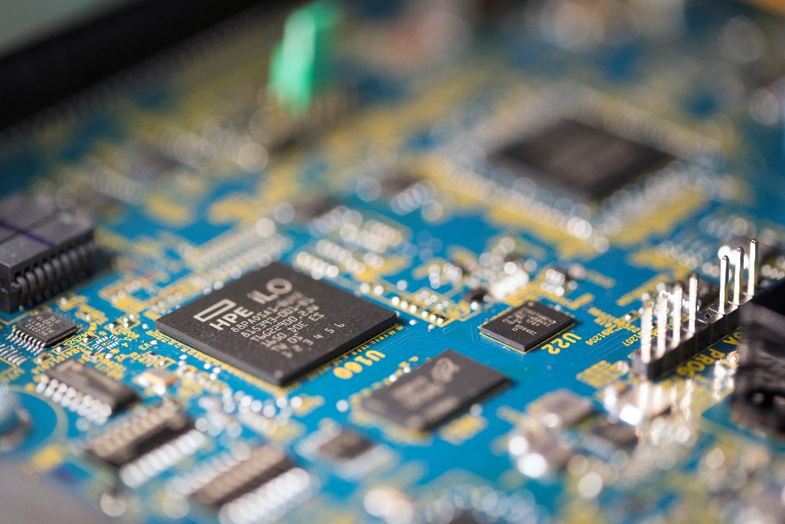
HPE ilo Advanced extended trial
Q&A
Q1. Why is HPE doing this?
A1. While businesses are making employees work from home during COVID-19 lockdown, it’s more important than ever to for server administrators to be able to manage servers remotely. The iLO Advanced license give admins the capability to manager servers as if they were at the console. HPE is therefore giving customers and partners the ability to turn on iLO Advanced for the rest of 2020 to help them manage through this new reality.
Q2. I already downloaded the 60-Day Trial License. Can I still apply for the new license to use through the end of the year?
A2. Yes. HPE designed a new key that enables this offer to take priority over the 60-Day Trial offer. You can therefore utilize this key on servers that have previously used the 60-Day Trial offer.
Q3. Is there any support offered for iLO under this license?
A3. Call in support is not included with this offer. iLO documentation is available at www.hpe.com/info/ilo/docs
Q4. Will this license work with my older server? Gen9? Gen8? Gen7?
A4. Yes.
What: HPE iLO Advanced is free to use for the rest of 2020!
Audience: All HPE Customers and Partners
Timeframe: License expires Jan 1st, 2021
Questions: Allen Whipple Whipple@hpe.com
iLO
Download Trial License in 5 Steps
Step 1: Go to the iLO home page www.hpe.com/info/ilo
Step 2: Click on the green box “Try iLO Advanced”
Step 3: Enter info requested in the form and click “Go to Download”
Step 4: Click on Download
Step 5: Acknowledge Welcome Email Confirmation
Customers downloading licenses through Nov 2, 2020 will get keys that will expire on Jan 1, 2021. Customer downloading licenses after Nov 2, 2020 will get key valid for 60 days from date of activation

Slide 18


HPE Server Security and Wellness Workshop
Course Dates & Schedule
All Sessions are: 11:30 AM – 2:30 PM time zone: EST
Upcoming Dates
September 10, 2020
September 22, 2020
October 8, 2020
October 22, 2020
Registration Link
http://www.hpe.com/ww/training/vc-ncsched?id=7864
Copy above link and click on United States and it will take you directly to registration
Key North America Contact
Allen Whipple whipple@hpe.com
*For USA/Canada students only
Course ID: H9SZ3S B.00
Cyber security is a critical issue for businesses today and HPE can help you navigate the risks. Let us protect your business, with the holistic security needed to address threats both today and tomorrow.
Course Briefing:
This HPE Server Security and Wellness Workshop provides an overview of server security, HPE iLO Amplifier Pack, HPE InfoSight for Servers, HPE iLO Advanced benefits, Intel Security, Pensando, and Cyber Catalyst ^{sm} Designation capabilities. The workshop will provide demonstrations of server security features, server discovery through HPE iLO Amplifier Pack, configuration of servers in HPE InfoSight for Servers, how to utilize the HPE InfoSight for Servers wellness and operational dashboards, and run wellness reports. A step by step cookbook will be provided.
Primary Audience: Customers, Partners, and HPE Field Sales
Course Content:
Intel Security
HPE Gen10 platform security
HPE iLO amplifier pack
HPE iLO Advanced benefits
HPE InfoSight for servers
Cyber Catalyst ^{sm} designation
HPE & Pensando
InfoSight for servers wellness reporting
“Today’s cyber threat is bigger than any one government agency – frankly, it’s bigger than government itself.”
– Christopher Wray, FBI Director

Slide 19
questions
Notes:
Claim: The World’s Most Secure Industry Standard Servers¹
Substantiation: ¹ Based on external firm conducting cyber security penetration testing of a range of server products from a range of manufacturers, May 2017.

