Slide 1
Capitalizing on Business Opportunities in K-12
Larry Staub
Director of Education Division

Slide 2
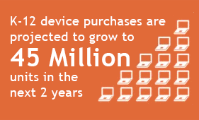
“This is a once in a decade sales opportunity”
-Microsoft
Notes:
This Number includes Chromebook, notebook, 2-in1, and tablets

Slide 3
Common Core State Standards
Schools need to become compliant by 2015.
Notes:
Common Core uses online testing so schools need to procure new or upgrade existing computing technology in their schools.
Therefore, it creates a huge sales opportunity.
The Common Core State Standards for English Language Arts & Literacy in History/Social Studies, Science, and Technical Subjects (“the Standards”) are the culmination of an extended, broad-based effort to fulfill the charge issued by the states to create the next generation of K–12 standards in order to help ensure that all students are college and career ready in literacy no later than the end of high school.
The Standards for Mathematical Practice describe varieties of expertise that mathematics educators at all levels should seek to develop in their students. These practices rest on important “processes and proficiencies” with longstanding importance in mathematics education. The first of these are the NCTM process standards of problem solving, reasoning and proof, communication, representation, and connections. The second are the strands of mathematical proficiency specified in the National Research Council’s report Adding It Up: adaptive reasoning, strategic competence, conceptual understanding (comprehension of mathematical concepts, operations and relations), procedural fluency (skill in carrying out procedures flexibly, accurately, efficiently and appropriately), and productive disposition (habitual inclination to see mathematics as sensible, useful, and worthwhile, coupled with a belief in diligence and one’s own efficacy).

Slide 4
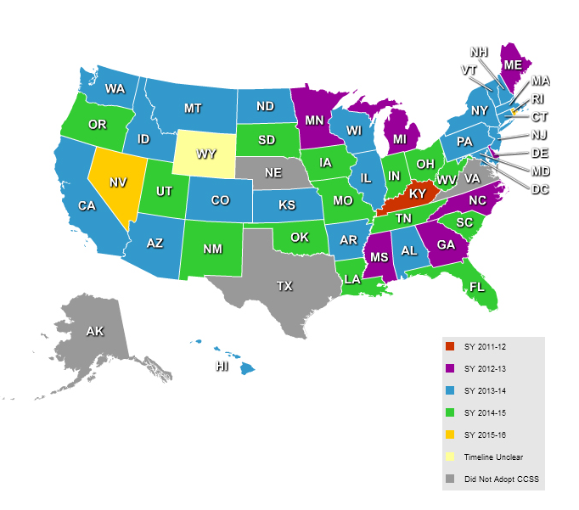
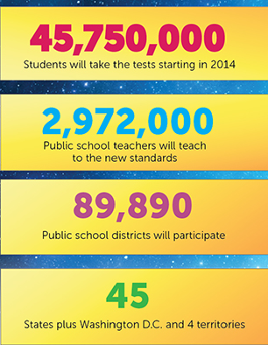
Common Core by the Numbers
Source: pcmag.com ShotTracker
Notes:
The Common Core classroom will be filled with digital tools – applications to support dynamic
learning and manage student information, and content for teachers to leverage in their
instruction.

Slide 5
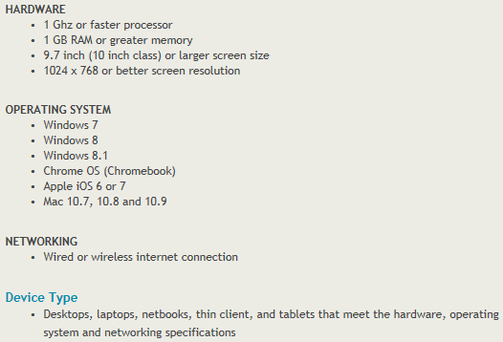
Common Core Guidelines

Slide 6
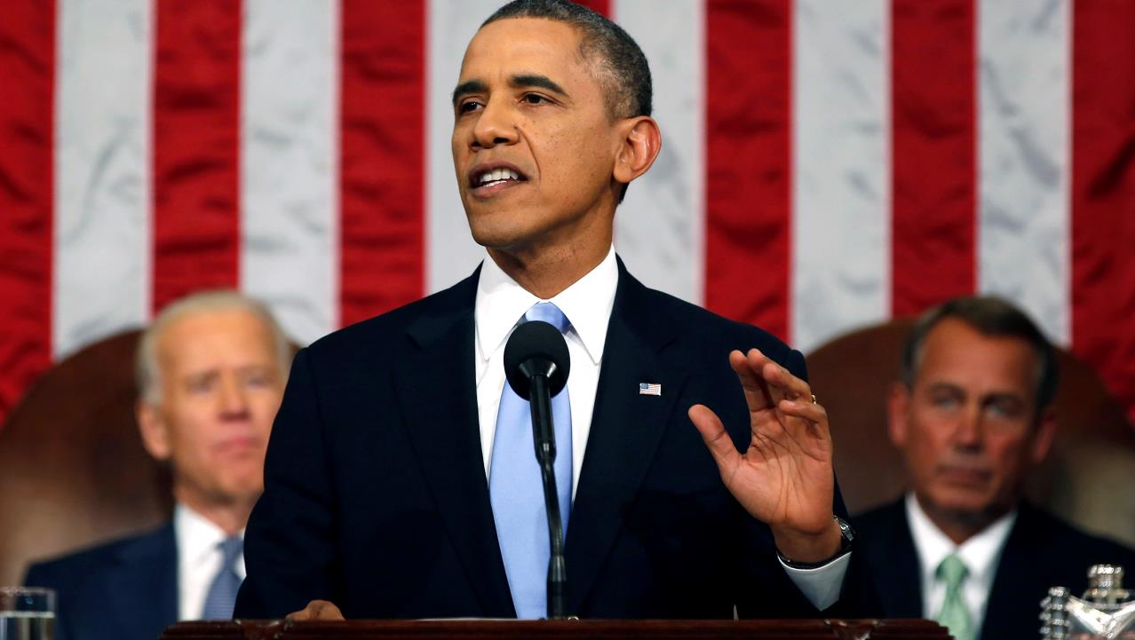
President Obama announced a broad education initiative called ConnectED in the 2014 State of the Union speech
Connecting America’s schools | Improving teaching | Unleashing private-sector innovation
Notes:
During his State of the Union address, President Obama directed the federal government to make better use of existing funds to technology into classrooms, and into the hands of teachers.
He is calling on businesses, states, districts, schools and communities to support this vision.
He stated that through “companies like Apple, Microsoft, Sprint, and Verizon, we’ve got a down payment to start connecting more than 15,000 schools and 20 million students over the next two years, without adding a dime to the deficit. We’re working to redesign high schools and partner them with colleges and employers that offer the real-world education and hands-on training that can lead directly to a job and career.”
Preparing America’s students with the skills they need to get good jobs and compete with countries around the world
Relies heavily on interactive, individualized learning experiences driven by new technology.
Upgraded connectivity
Leveling the playing field for rural students
Trained teachers
New resources for teachers
Educational devices for students
Exposing students to global opportunities
Support for digital educational content
Restoring US leadership in vital areas

Slide 7
ConnectED’s Support
Microsoft is offering discounted Windows based notebooks, tablets, and devices through its Hardware Partners; $1 billion commitment
Apple is pledging $100 million in iPads.
Notes:
Microsoft – “Shape the Future” = $1 Win Pro 8.1 utilizing all their OEM devices manufacturers; HP, Lenovo, ASUS, Acer, Dell, etc…
Lots of iPad cases are going to be needed by the schools and storage/charging carts.
AT&T and Sprint are pitching in with a pledge to provide free wireless service to students.
Verizon will invest $100 million in cash and other contributions to accelerate the development of teachers dealing with science, technology, engineering, and math.
The Federal Communications Commission is also expected to set aside service fees over two years to connect another 20 million students to broadband Internet.

Slide 8
Microsoft’s K-12 EDU Offerings
Special Low EDU price for Windows 8.1 Pro
Free professional development for teachers through Partners in Learning
K-12
Single Letter of Eligibility for all K-12 public schools
Ad-free search with Bing for Schools
No additional cost to students for Office 365
Low-cost broadband available through EveryoneOn non-profit
Notes:
Win 8.1 Pro Offer through OEM Partners - optimized for touch and digital inking, critical keys to better learning outcomes.
Communication & Collaboration with Office 365 Education and Student Advantage - Office 365 ProPlus to students free of charge when their institution purchases Office for all faculty and staff
Ad Free Search using Bing for Schools providing digital literacy platform aimed at helping students learn important digital skills
Teacher Training & Resources: Partners in Learning Network offers educators a forum to share ideas, free lesson plans to inspire classroom learning, and supplement professional development
Partnership with EveryoneOn – Broadband offering home Internet service for as low $10 to the 36 million Americans living in communities with low median incomes

Slide 9
Shape the Future – What It Really Means
$1
Win 8.1 Pro from hardware partners on select skus
ALL PUBLIC SCHOOLS QUALIFY
LOE (Letter of Eligibility)
http://nces.ed.gov/ccd/schoolsearch
LOE valid through 1/24/15
Notes:
$1 Win 8.1 Pro = compete with Chromebook
HP, Lenovo, ASUS, Acer, Dell (mostly commercial division selling direct)….Samsung not participating
Office 365 ProPlus to students free of charge when their institution purchases Office for all faculty and staff (Microsoft Student Advantage Program).
Microsoft’s Mission Statement for Shape the Future - Through creative Public-Private Partnerships, we help governments achieve their broad scale digital access goals - from education reform to creating a 21st century workforce.
LOE will most likely be extended beyond 1/24/15

Slide 10
“Shape the Future” Ordering Process
1
2
3
4
School contacts Reseller and requests devices.
School provides a copy of the Letter of Eligibility (LOE)
Reseller contacts D&H and places order for Devices
D&H validates that
the school is eligible to procure the National Academic Offering SKU..
D&H provides reseller the devices with the Windows 8.1 Pro National Academic Offering
Notes:
- This process starts after the school has issued a bid, a reseller as provided a quote and has at this point won the bid.
Shape The Future also covers Win 7 Pro
If school buys Win8.1 Pro and wishes to downgrade to Win 7 Pro they are able to do so

Slide 11
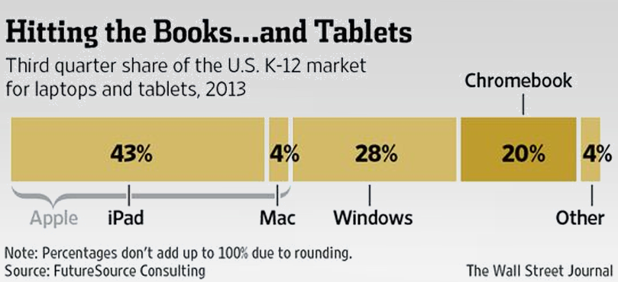
Chromebook

Slide 12
D&H is Here to Help You!
D&H is your Chromebook™ Destination
Notes:
Banner on the Computer Products and Education Home Pages of DandH.com
Takes customers to a list of all the Chromebooks we have set-up (currently 19).
Samsung
Acer
HP
ASUS (coming)
Lenovo (coming)

Slide 13
D&H is Here to Help You!
Chromebook™ Partner Services Template
Notes:
FREE Customizable marketing resources:
Chromebook Partner Service Template – ready now

Slide 14
D&H is Here to Help You!
K-12 Objectives Partner Services Template
Notes:
FREE K12 Partner Services Template – ready now
Focuses on upgrading the classroom

Slide 15
Find All the Info You Need in One Place!
Visit the K12 Opportunity Page on dandh.com
www.dandh.com/k12
Notes:
If you’re currently focused on K-12 schools and working on bids, D&H is ready to help:
- Streamlined bid process
- Increased inventory support
- Aggressive bid pricing
- Forecasting, planning and support
- Credit options to help with sizable bids
We must make our schools an integral part of the broadband and technology transformation - particularly when that same technology can be harnessed to drive empowered, more personalized learning.
Focus skus by vendor

Slide 16
Opportunities Beyond Computer Hardware
Protective Cases
Charging / Storage Carts
Networking
Headphones
Projectors
Screens
Smart boards
Notes:
Vendors all have different processes for bids
Protective cases –Targus, Case Logic, Otterbox (D&H only distributor with the bulk product for the iPad2, AIR and Mini)
Charging / Storage Carts – Datamation, Woodware
Networking – Cisco, Linksys, Netgear
Headphones – AVID, Koss
Projectors – Benq, InFocus, Epson, Viewsonic, NEC, Acer, ASUS, Optoma
Screens – Elitescreens, Epson
Smartboards
How each plays into common core

Slide 17
Credit Options
Net Terms (including EFT & PayNet)
Assignment of Funds
Flooring or Leasing
Notes:
Visit the Credit Services page https://www.dandh.com/v4/view?pageReq=creditresource or contact your sales rep for more information.
D&H Distributing Co. offers an Assignment of Funds program. Generally, this is used when a reseller wins a large bid that his/her own credit line cannot accommodate.
Purchase Order: The purchase order is required to verify the order directly through the end-user before shipping.
Joint Remit Agreement: This must be signed by the end-user, stating that they agree to the terms and manner of payment to D&H.
Power of Attorney: Since checks from the end-user will be made out to you, we require power of attorney to cash them and send you the profit.
Through one of our finance partners, you can easily offer your end users creative and efficient leasing products that can help you grow your business. D&H has partnered with the following financial institutions:
GE Commercial Distribution Finance
Marlin Leasing Tools
Application – online lease application form
Quoter – get real time lease rates and payment quotes on a variety of lease options
IBM Credit
De Lage Landen (DLL)
Castle Pines Capital LLC
You'll need to provide your sales rep with the flooring company, your account number and purchase order at the time of your order.

Slide 18
Thank you!
Questions?

