Slide 1

Windows Server 2025
Share the benefits of selling and buying Windows Server 2025
with this seller/customer deck.
Cloud connected for business innovation

Slide 2






Why OEM ROK for Windows Server?
Easy (no contracts to sign)
Perpetual
Server and License sold together by reseller
Lowest Price
Physical Product
Notes:
Reassignment rights are typically not included (except for SQL Server)

Slide 3

Types of Windows Server
OEM Licenses
ALL LICENSING TYPES ARE INCLUDED IN TCE (TOP CHOICE EXPRESS)
Reseller Option Kit (ROK)
Drop in Box (DIB)
Configure to Order
PRE-Install (CTO)
Notes:
ROK: Most common, stocked by distributors
DIB: Available, dropped in the box with the server and shipped direct to customers or through distributors
CTO: Available, preloaded on the server drive in the factory and shipped direct to customers or through distributors

Slide 4
Windows Server 2025 Editions
Windows Server 2025 Essentials Edition | Windows Server 2025 Standard Edition | Windows Server 2025 Datacenter Edition
Ideal for small businesses with up to 25 users or 50 devices | Ideal for customers with physical or minimally virtualized environments | Ideal for highly virtualized and software defined datacenter environments
25 users / 50 devices (CALs not required) | Unlimited (based on CALs) | Unlimited (based on CALs)
1 physical or virtual | 2 VMs | Unlimited VMs
Must be root of domain Available in ROK and OEM No COEM/VOL 1 Socket with max 10 cores only [Only available from OEMs] | 2 Hyper-V containers | Unlimited Hyper-V containers

Slide 5

Version Comparison Guide
Feature | Windows Server 2019 | Windows Server 2022 | Windows Server 2025
SMB over QUIC
Hotpatching (in preview)*
Enhanced Hybrid Cloud Capabilities
Decoupled Host and Container Upgrades
Advanced Active Directory Security
Link to full comparison guide: Comparison of Windows Server editions | Microsoft Learn
Link to compact comparison guide: Windows Server Comparison Guide
*enabled with Azure Arc. Requires a subscription.

Slide 6
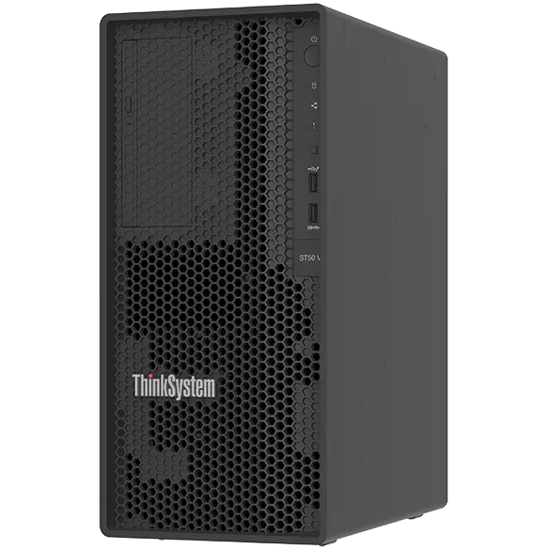
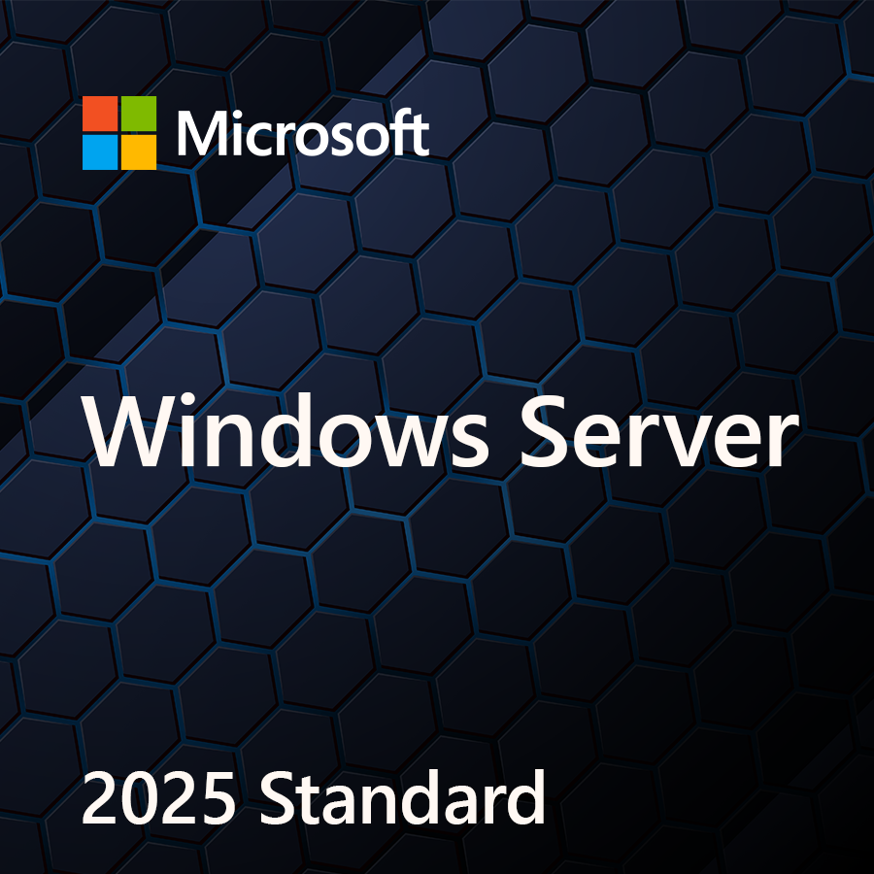
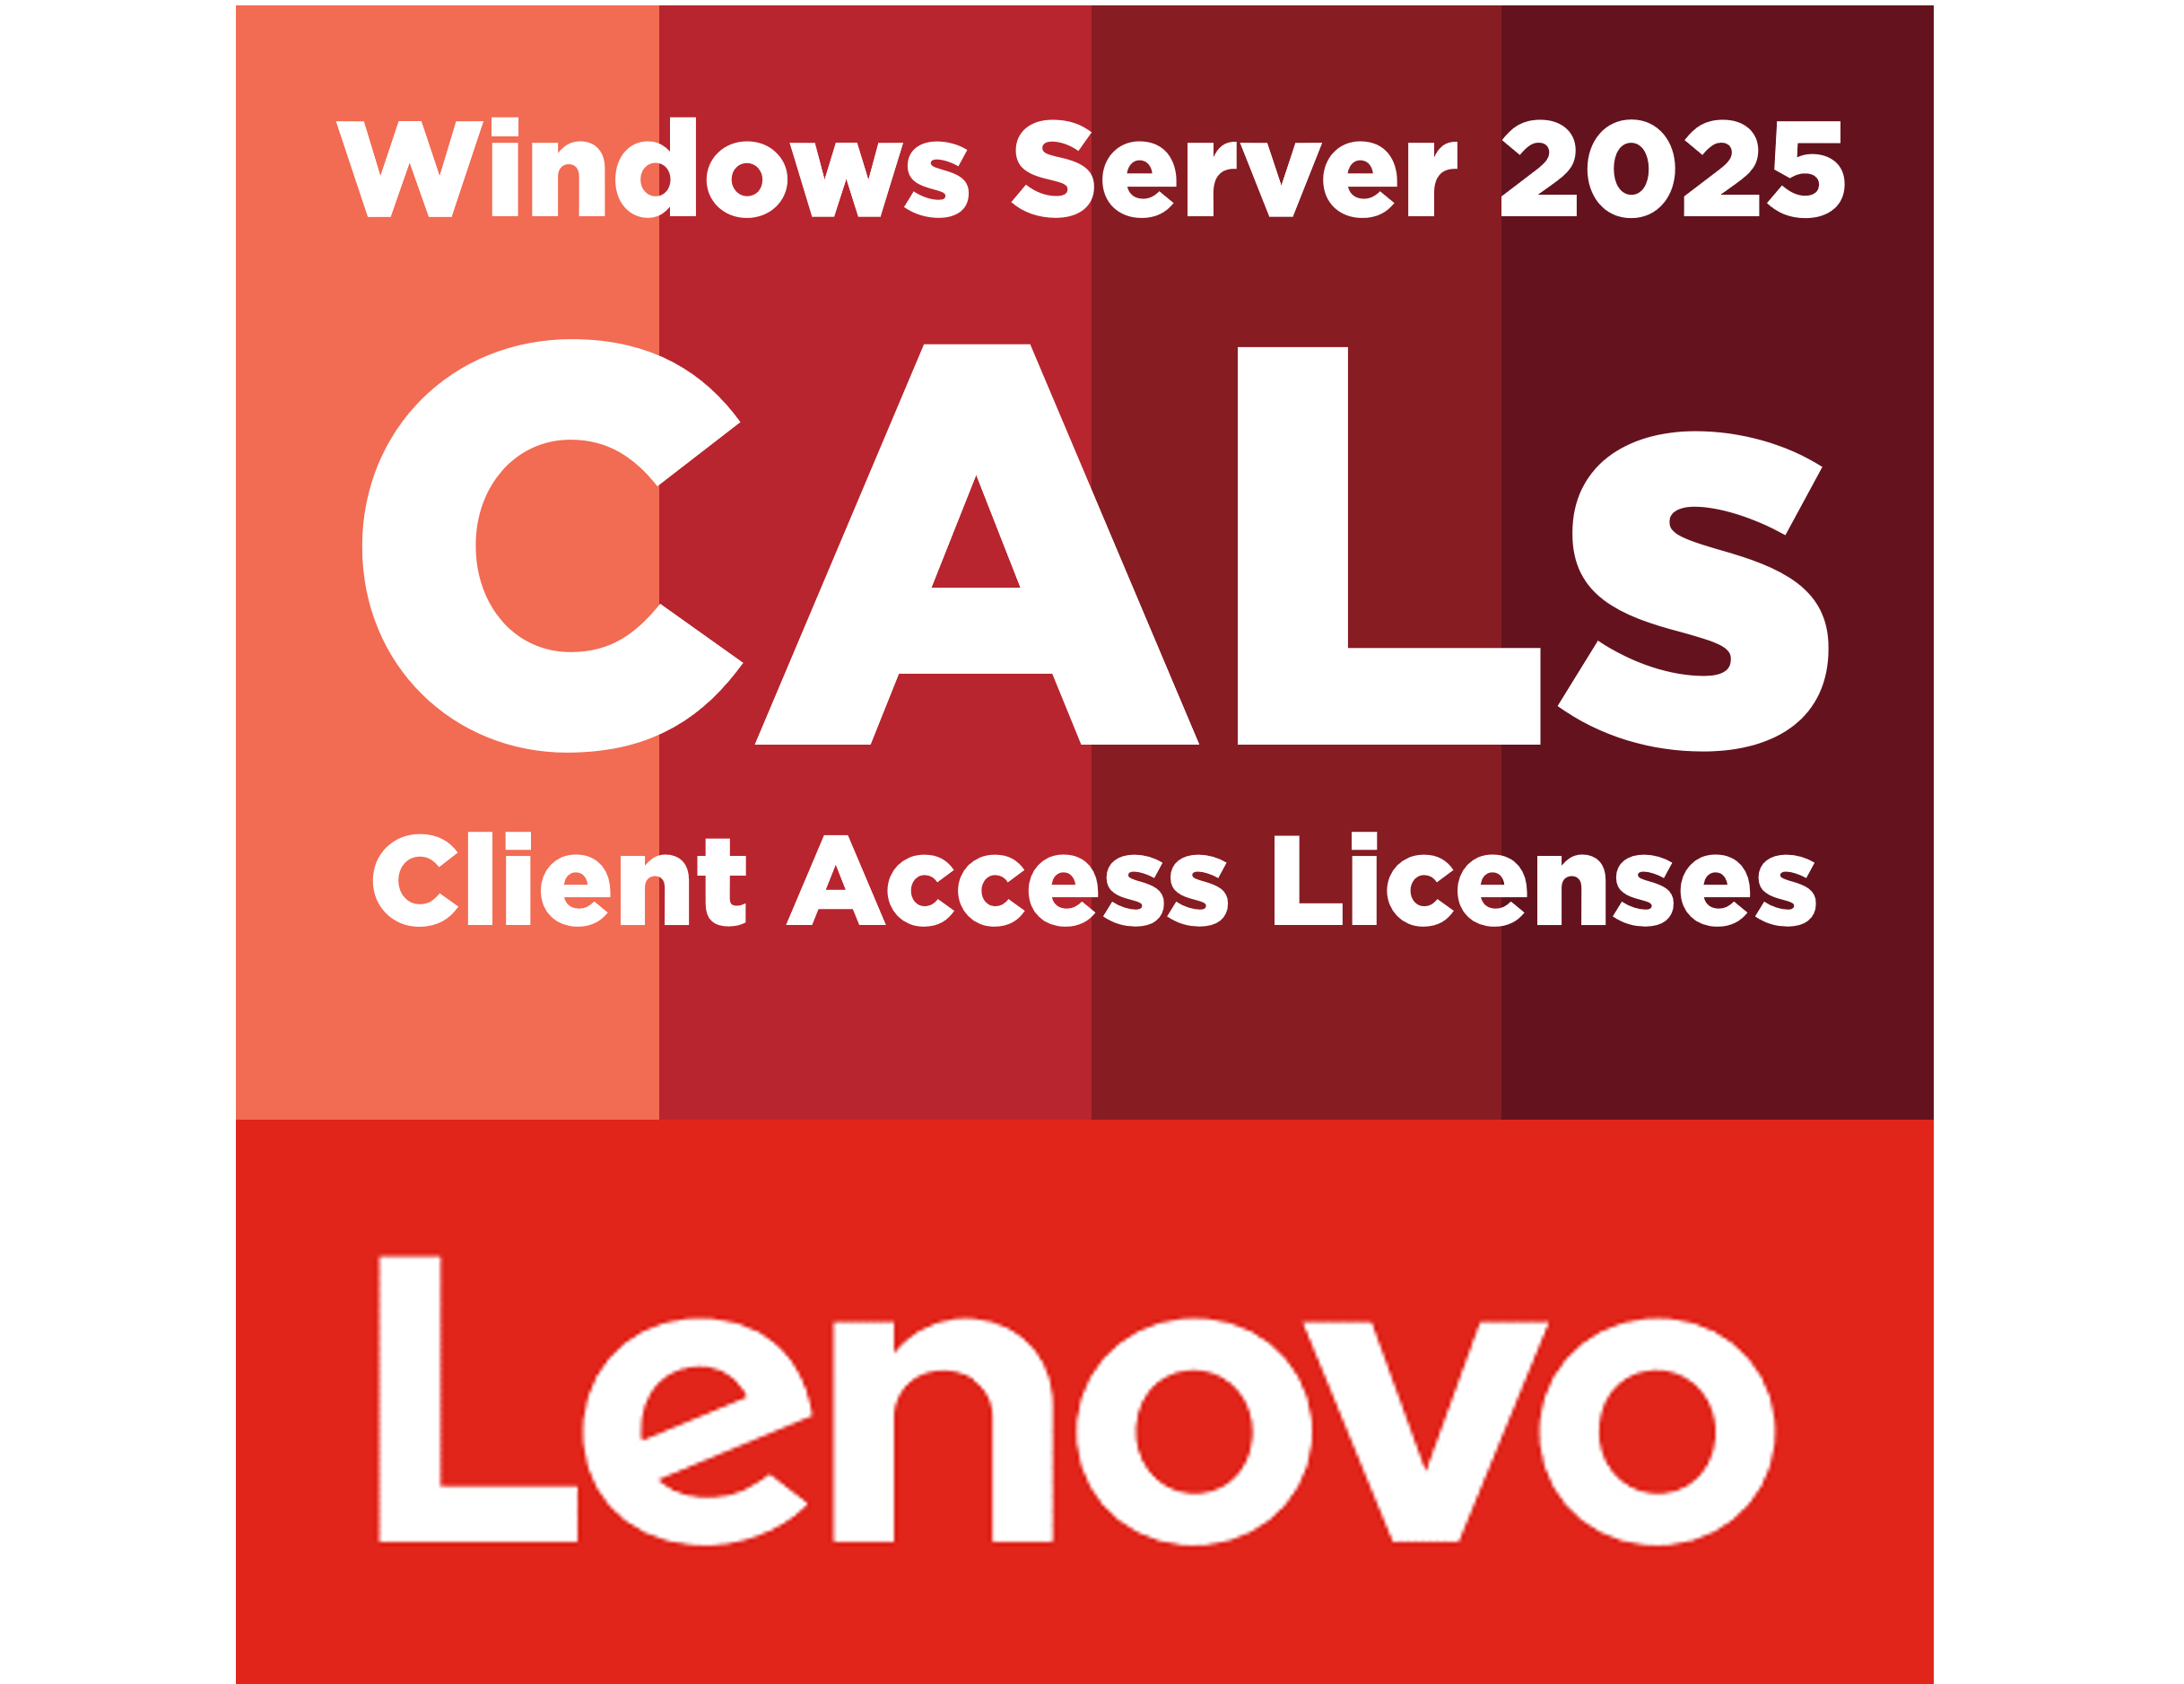
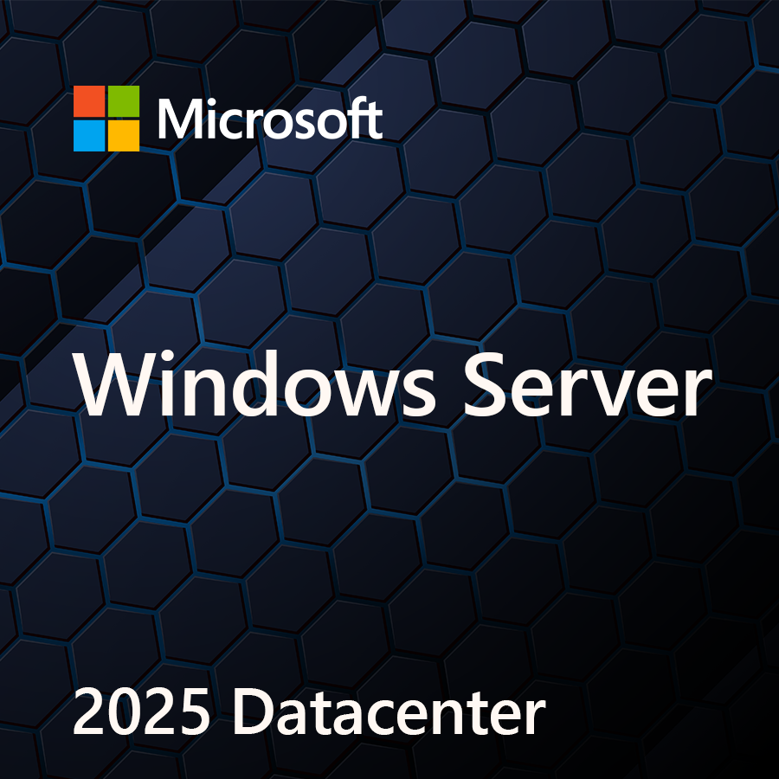
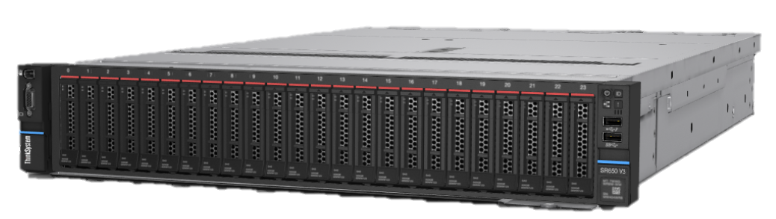
2 Category + 3 column deep layout
Accelerate quota retirement with software attach
SELLING
STANDARD
+
+
=
$2,250
More than 2X toward revenue targets vs. server only
$900
(ThinkSystem ST50 V3)
$900
(16 core OS)
$450
(10 pack)
SELLING
DATACENTER
+
+
=
$12,250
More than 2X toward revenue targets vs. server only
$5,000
(ThinkSystem SR650 V3)
$5,000
(16 core OS)
$2,250
(50 pack)
Get to quota retirement even faster by adding SQL Server and RDS CALs.
Notes:
Add software to your hardware deals and retire your sales quota more quickly. Also, you may be eligible for SPIFFs or rebates in select markets.

Slide 7
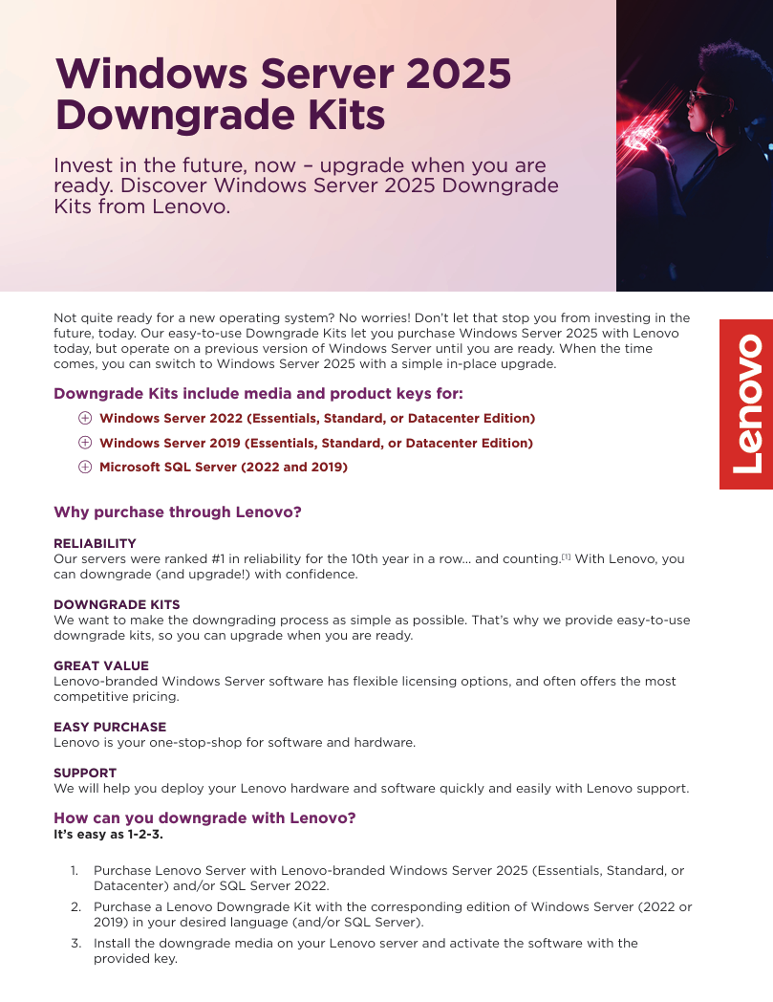


Downgrade Kits
Help your customers invest in the future, even if they aren't ready to upgrade yet.
Downgrading with Lenovo is easy!
Find more resources on downgrading with Lenovo on the Lenovo Sales Portal.

Slide 8

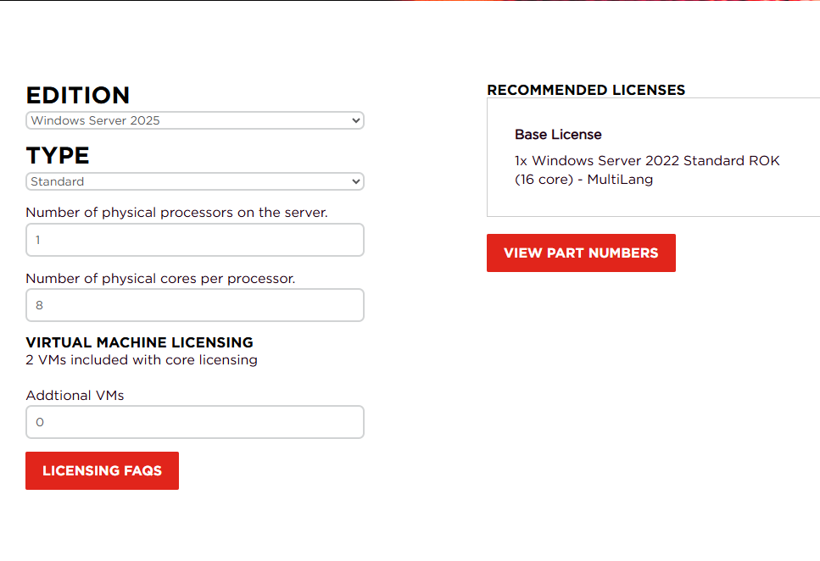
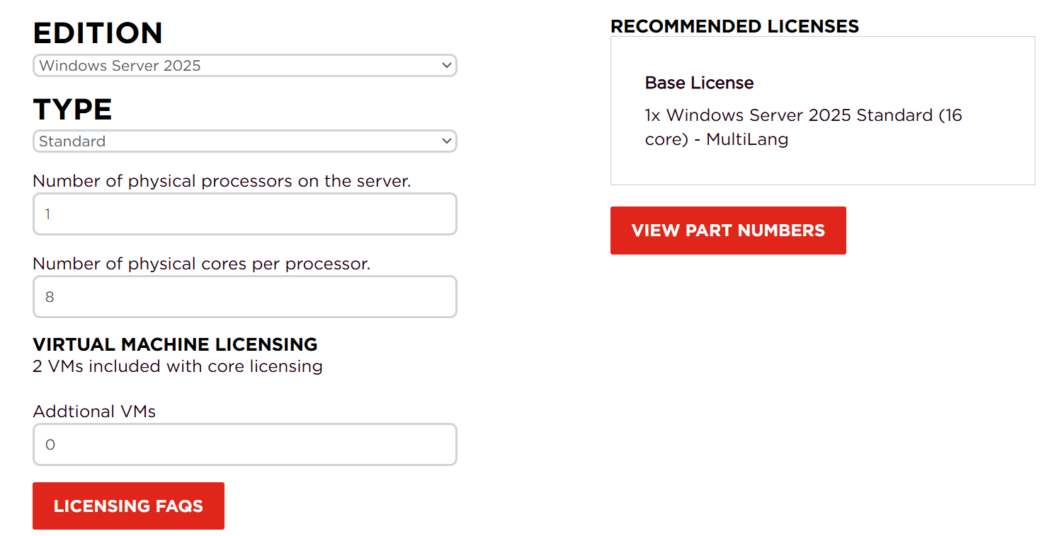
Licensing Calculator
Quickly and easily find the licenses your customers need.
Find more resources on
Windows Server 2025 licensing with Lenovo on the Lenovo Sales Portal.

Slide 9


2 section block + photo layout
Resources
Evaluation Link
Microsoft Learn Page
Windows Server Summit Video Gallery
Windows Server 2025
Asset Links
(Lenovo Sales Portal)
Microsoft Ignite Presentation
on Windows Server 2025

Slide 10

Sellers: Keep it simple!
Attach Lenovo OEM licenses to every quote to increase revenue
*Now included in TCE and Mission Acquisitoin!
Security is top of mind! (Windows Server 2025 + Lenovo = the most secure Windows Server yet)
Windows Server 2025 is a great option for customers looking to migrate from VMware or older versions of Windows Server
Windows Server 2025 has a ton of new innovations! Study and familiarize yourself with what’s new in Windows Server 2025

Slide 11
thanks

