Slide 1

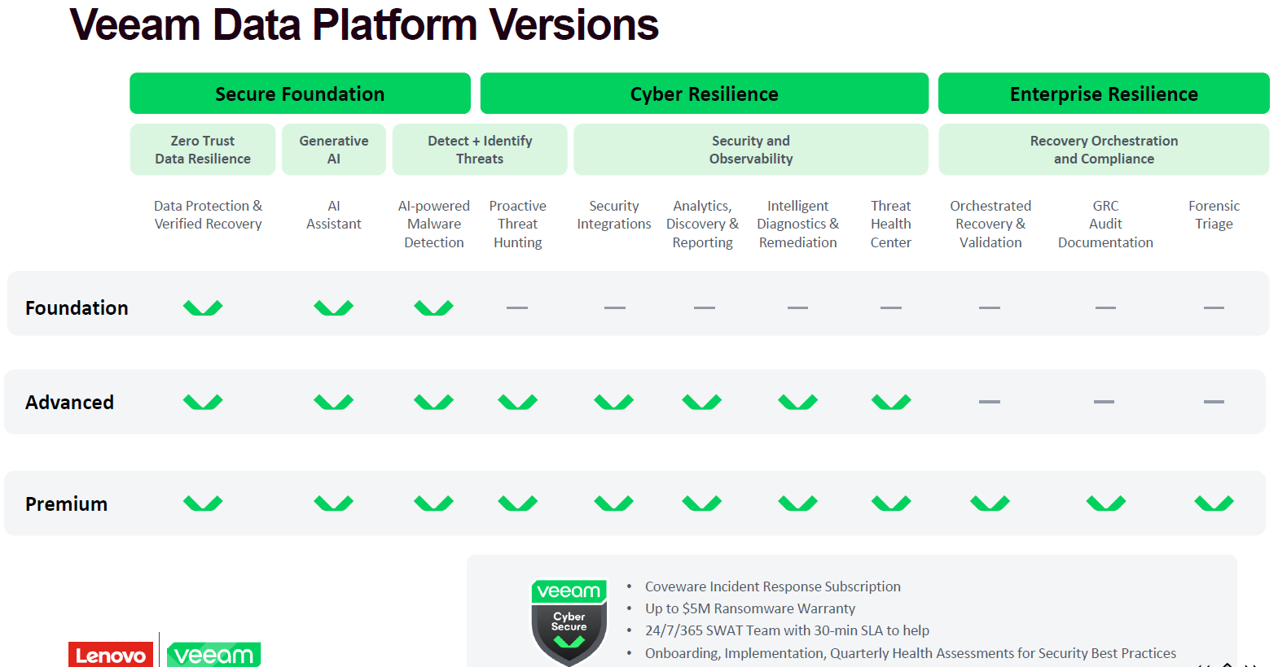

Slide 2

Conversation Card
Elevator Pitch
Lenovo offers a full suite of backup and disaster recovery solutions from industry leader, Veeam Software. Together with Lenovo’s portfolio of top-quality servers and storage products, customers can feel secure in their data recovery solution in the unfortunate case that a data integrity event occurs such as a ransomware attack. It is critical for both small and large companies to have reliable and secure data backup solutions.
Why Veeam?
Why Lenovo & Veeam?
Discovery Questions
Future Proof: The Veeam platform extends beyond core backup and recovery capabilities to address modern data protection needs, like DR orchestration, ransomware remediation and cloud mobility
One Platform: One platform to protect all virtual, physical, and cloud native workloads
Simple: Veeam is straightforward to deploy, easy to manage and designed to integrate effortlessly into your environment. Veeam does not require a steep learning curve either
Reliable: Veeam increases reliability, enhances security and ensures business continuity in the event of a ransomware attack or insider threat by automatically verifying backups are recoverable and free from malware through automated scanning, immutable storage and insider threat protection.
The Veeam Data Platform combined with best-in-class data center infrastructure and software-defined solutions from Lenovo, enables businesses of all sizes to accelerate digital transformation, simplify IT, reduce risk, lower costs and enhance business agility:
Secure Backup and Fast Recovery – Own, control, Backup and Recover all your data anywhere in the Hybrid Cloud
Proactive Monitoring and Analytics – Maintain full visibility for proactive management and recovery success
Proven Recovery Orchestration – Be compliant and ready for disaster with orchestrated recovery
Customer Benefits:
Avoid business productivity disruptions, fines, and legal actions that could affect brand reputation
Reliably protect data from accidental deletion, security threats, retention policy gaps and ransomware
Quickly restore individual items and files with industry-leading recovery flexibility
Meet legal and compliance requirements with efficient eDiscovery backup archives
Ransomware Protection
What is your process for ransomware protection?
How would you expect to recover from an unexpected ransomware attack?
What’s your current workflow to verify backups before restoring them to production?
What is your process for protecting your backups from tampering or deletion?
How often do you test to verify your backups are free of ransomware?
Are you looking to implement, store and/or manage backups in-house or are you interested in an ‘as-a-service’
Public Cloud (AWS, Azure, Google)
What is your strategy for protecting and managing hybrid/multi-cloud data?
How do you ensure your continuity of service in the event of an outage?
How do you currently protect workloads running in the cloud today?
Are you looking to implement, store and/or manage backups in-house or are you interested in an ‘as-a-service’
SaaS (Microsoft 365)
How do you protect your data in Microsoft 365 today?
How often do you have to recover Microsoft 365 data?
How long does it take to recover Microsoft 365 data?
How many Microsoft 365 users does your organization have?
2024 Lenovo. All rights reserved.

Slide 3
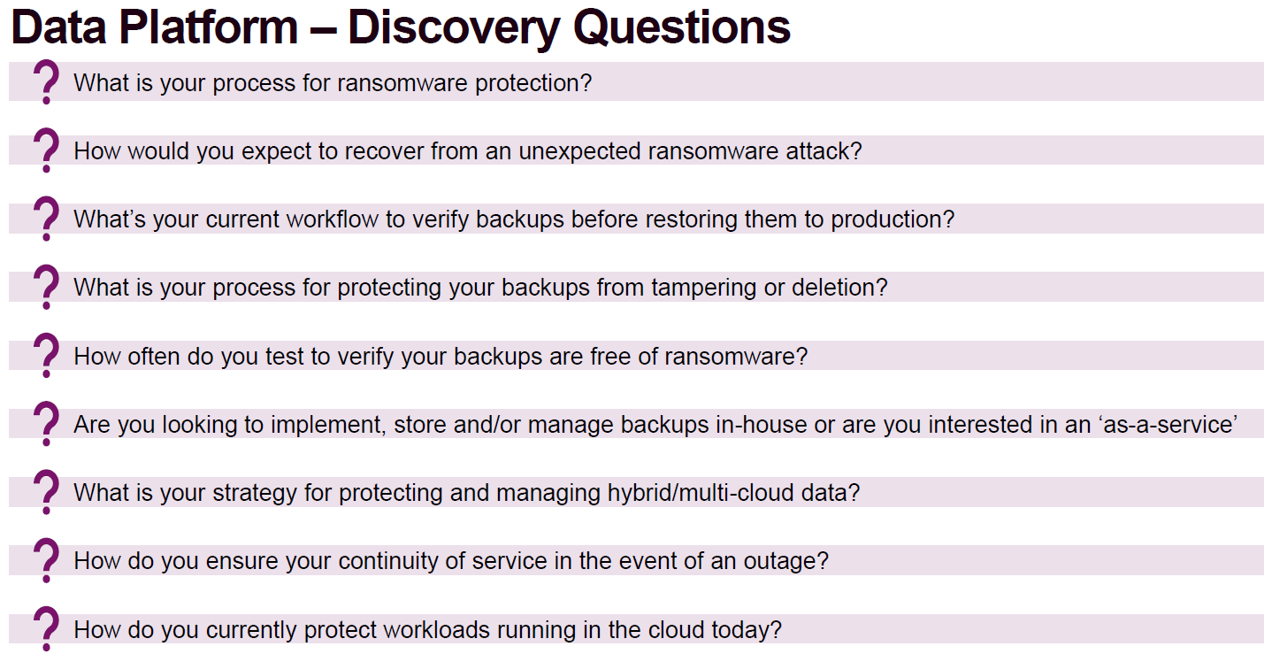

Slide 4

Lenovo / Veeam M365 Conversation Card
Elevator Pitch: With Microsoft 365, it’s your data – you control it – and it’s yours, not Microsoft’s, ultimate responsibility to protect it from various threats – from accidental deletions to malicious ransomware, and to comply with various governing regulations. Don’t put your business at risk – avoid productivity disruption, fines, lawsuits and legal actions, and loyalty and reputational damage by protecting your data right now with industry-leading, readily available, quick to deploy Lenovo Backup Solution for Microsoft 365 with Veeam.
Why sell Veeam Backup for Microsoft 365 (M365) and Lenovo together?
Keep Microsoft 365 data available, accessible, and secure at all time across hybrid, multi-cloud environments, mitigating risks of data loss and downtime, and ensuring data compliance, while reducing costs, with joint Lenovo and Veeam industry-leading, easy to get and deploy backup and recovery solution for Microsoft 365:
Highlight the industry-leading Lenovo ThinkSystem compute and storage solutions.
Include a M365 data protection solution that can be deployed on-premises and in the cloud.
Challenges with data loss
Data loss could lead to disruption of business productivity, high response and recovery costs, fines, lawsuits, and legal actions, and loyalty and reputational damage. Do you have a solid backup and disaster recovery strategy that helps prevent loss of your Microsoft 365 data?
Microsoft 365
On-premises
Exchange
Online
Teams
SharePoint
Online
OneDrive
for Business
Lenovo File or Block Storage (Server-based,
DE Series, DM Series)
Object Storage
Backups
Why would a customer be interested?
Approximately 3 of 4 customers experienced data loss within the cloud. Among the key reasons, user error/accidental deletion is the most frequent one, followed by retention policy gaps (thinking that something was protected that was not, actually) and security threats (malicious insiders, ransomware, malware).
Microsoft’s shared responsibility model: Microsoft is responsible for the uptime of their infrastructure, and customers are responsible for access and control of data residing in the Microsoft 365 cloud.
To avoid business productivity disruption, fines, lawsuits and legal actions, and loyalty and reputational damage.
Veeam Backup
for Microsoft 365
Cloud
On-premises
IBM Cloud
Object Storage
Amazon S3
Azure
Blob
Other S3
Storage
Exchange
SharePoint
Customer Benefits
Reliably protect M365 data from accidental deletion, security threats and retention policy gaps
Quickly restore individual M365 items and files with industry-leading recovery flexibility
Meet legal and compliance requirements with efficient eDiscovery of M365 backup archives
Buyer Trigger Points
Need to protect M365 data from user errors/accidental deletion
Need to protect M365 data from security threats (ransomware, malware, malicious insiders)
Need to protect M365 data from retention policy gaps (thinking it is protected while it’s not)

Slide 5
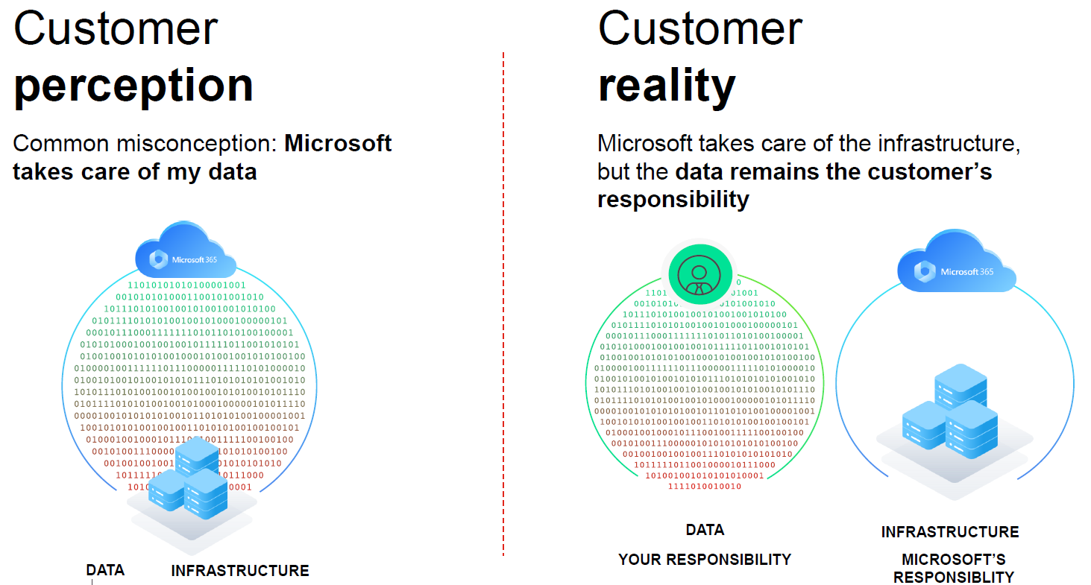

Slide 6
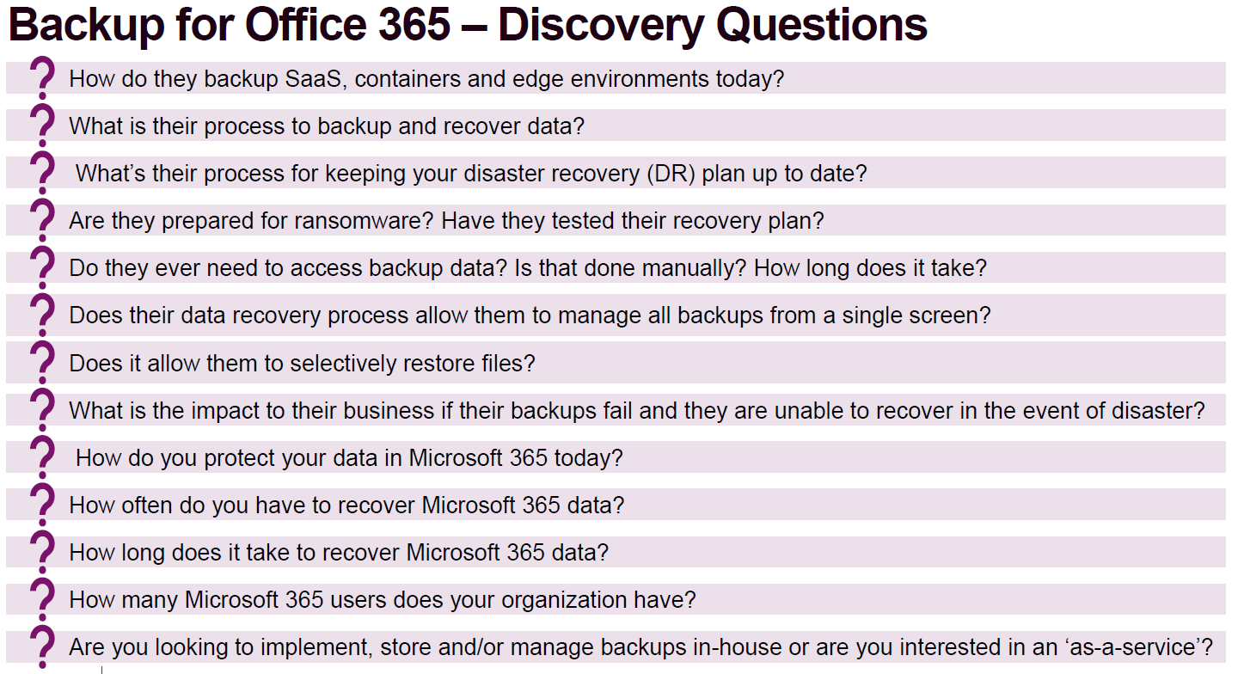

Slide 7
