Slide 1



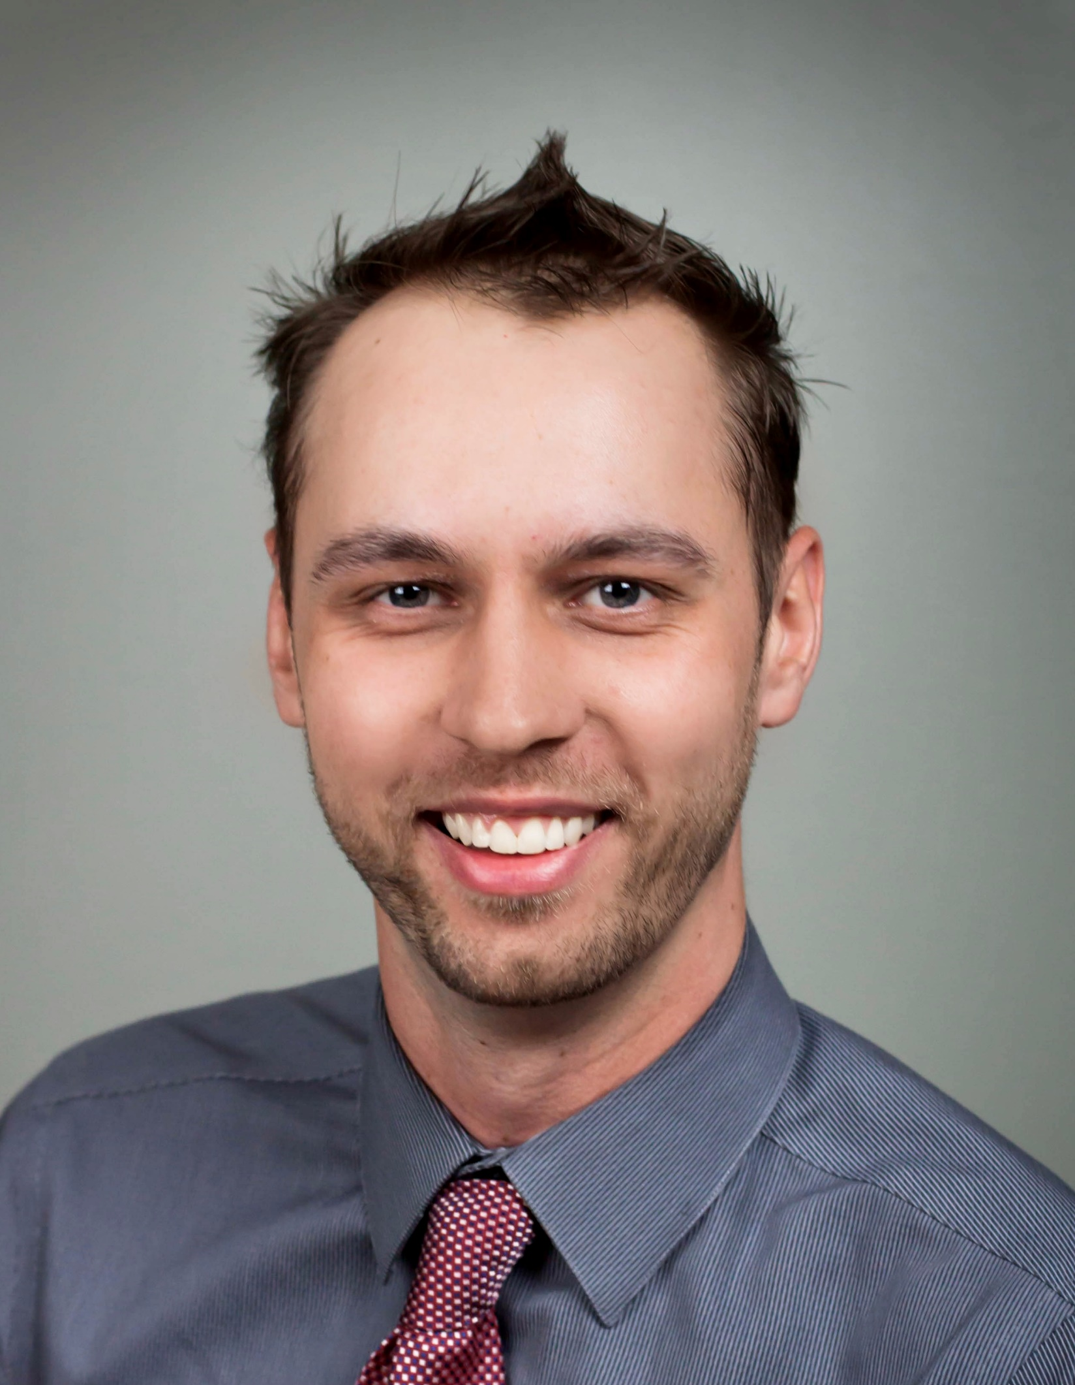
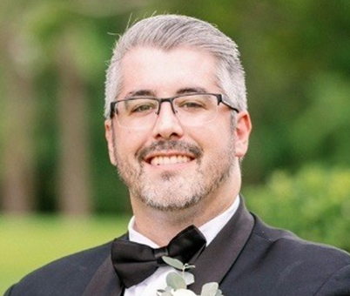
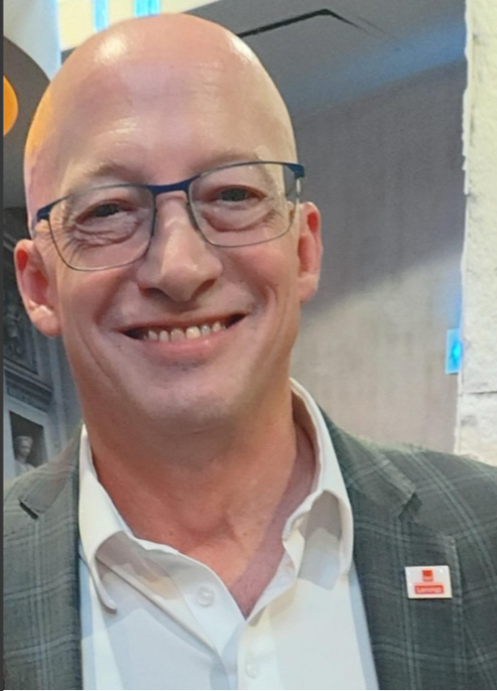


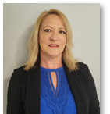
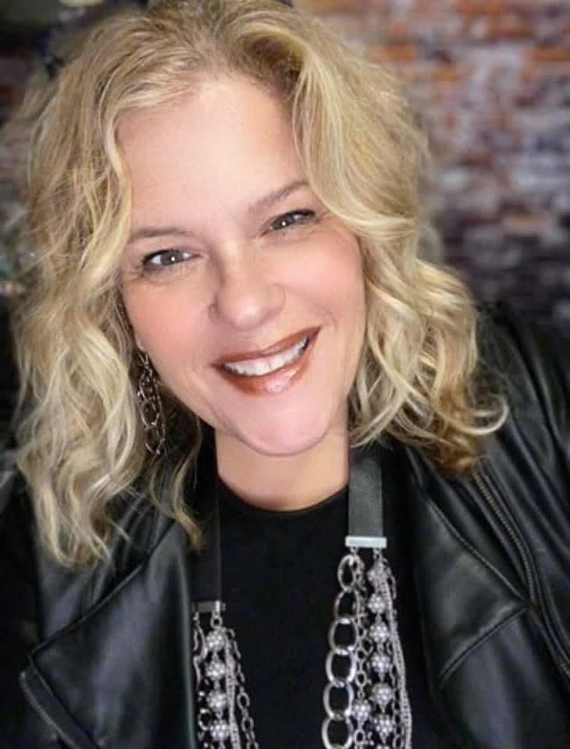
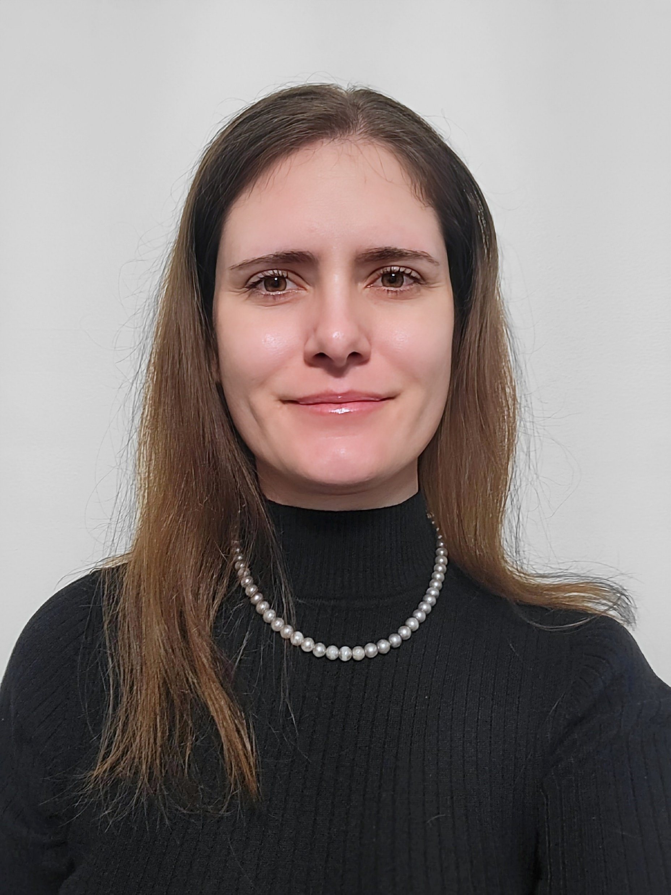
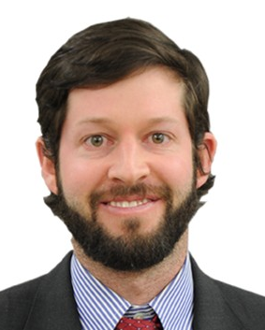
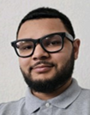
D&H ISG – Advanced Solutions+ Team:
Lenovo ISG Requests: LenovoServer@dandh.com
Technical Sales Engineer:
Sales Support:
Leadership:
ISG
Shawn Stopa
ISG Technical Sales Engineer
sstopa@dandh.com
Chuck Boyer
ISG Business Unit Director
chboyer@dandh.com
Andrew Strickland
ISG Sr. Sales Specialist, Team Lead
astrickland@dandh.com
Jeff Cagle
ISG Sales Specialist
jcagle@dandh.com
Jessica Pye
ISG Sales Support Specialist
jpye@dandh.com
Reasean Crayton
ISG Sales Support Specialist
rcrayton@dandh.com
Bobby Fera
ISG Technical Sales Engineer
rfera@dandh.com
Vendor Business Manager:
Dawn Lazzaro
ISG Vendor Business Manager
dlazzaro@dandh.com
Business Development Managers:
Shannon Saksaka - East
ISG Business Development Manager
ssaksaka@dandh.com
Andrew Ramirez - West
ISG Business Development Manager
aramirez@dandh.com
Additional Links:
Lenovo Partner Hub:
https://www.lenovopartnerhub.com
Lenovo Configurator (DCSC):
https://dcsc.lenovo.com
Mission Acquisition Program is Back for ISG Deals!
Additional 5% for Qualifying End-Users for 12 Months!
(Stackable With the Deal Registration)
Ask Us About Lenovo’s Top Choice Express Program!
Top Choice Builds/Orders Offer Best Pricing & Ship within 10 days!
“TCE” Server & Storage Solutions Available!
Confidential & proprietary. Do not distribute.

