Slide 1
Workstation Expert Program 2.0

Slide 2
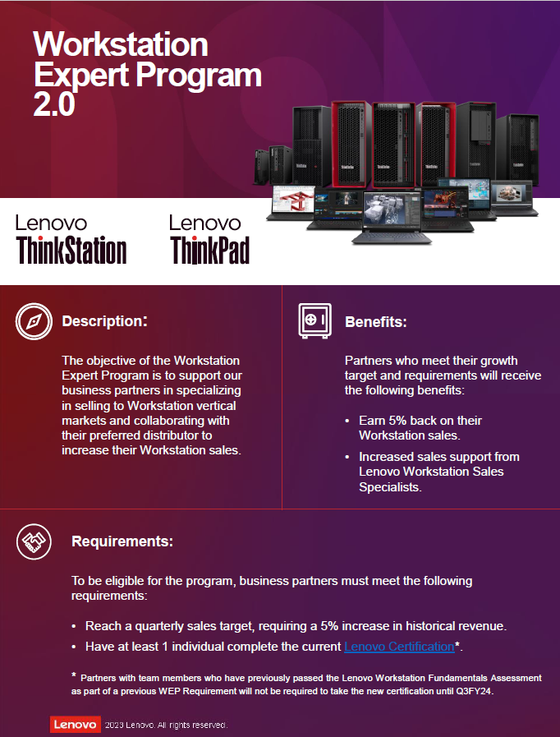
Help grow authorized partners using workstations and certifications.
The main goal is to finish the year with 18% growth rate for WE 2.0 partners.

Slide 3
WEP Framework for Disty:
Distribution will be paid 2% for all WEP Partners and T2 meeting the requirements.
Disty Responsibilities
Help the partner hit the assigned goal.
Follow up and engagement with LPS.
Provide support to the accounts assigned in order to grow the workstation business
WEP Framework for Partner Partner:
Description:
The Workstation Expert Program is designed to help our business partners who want to specialize selling into Workstation vertical markets.
Requirements:
BP will be assigned a target each quarter, which must be met
Must have a minimum of 1 individual complete the Lenovo online training courses & certification.
Benefits:
Earn 5% on the WS Sales for hitting growth targets & Certification.
Increased sales support from Lenovo Workstation Sales Specialists and Alliances

