Slide 1
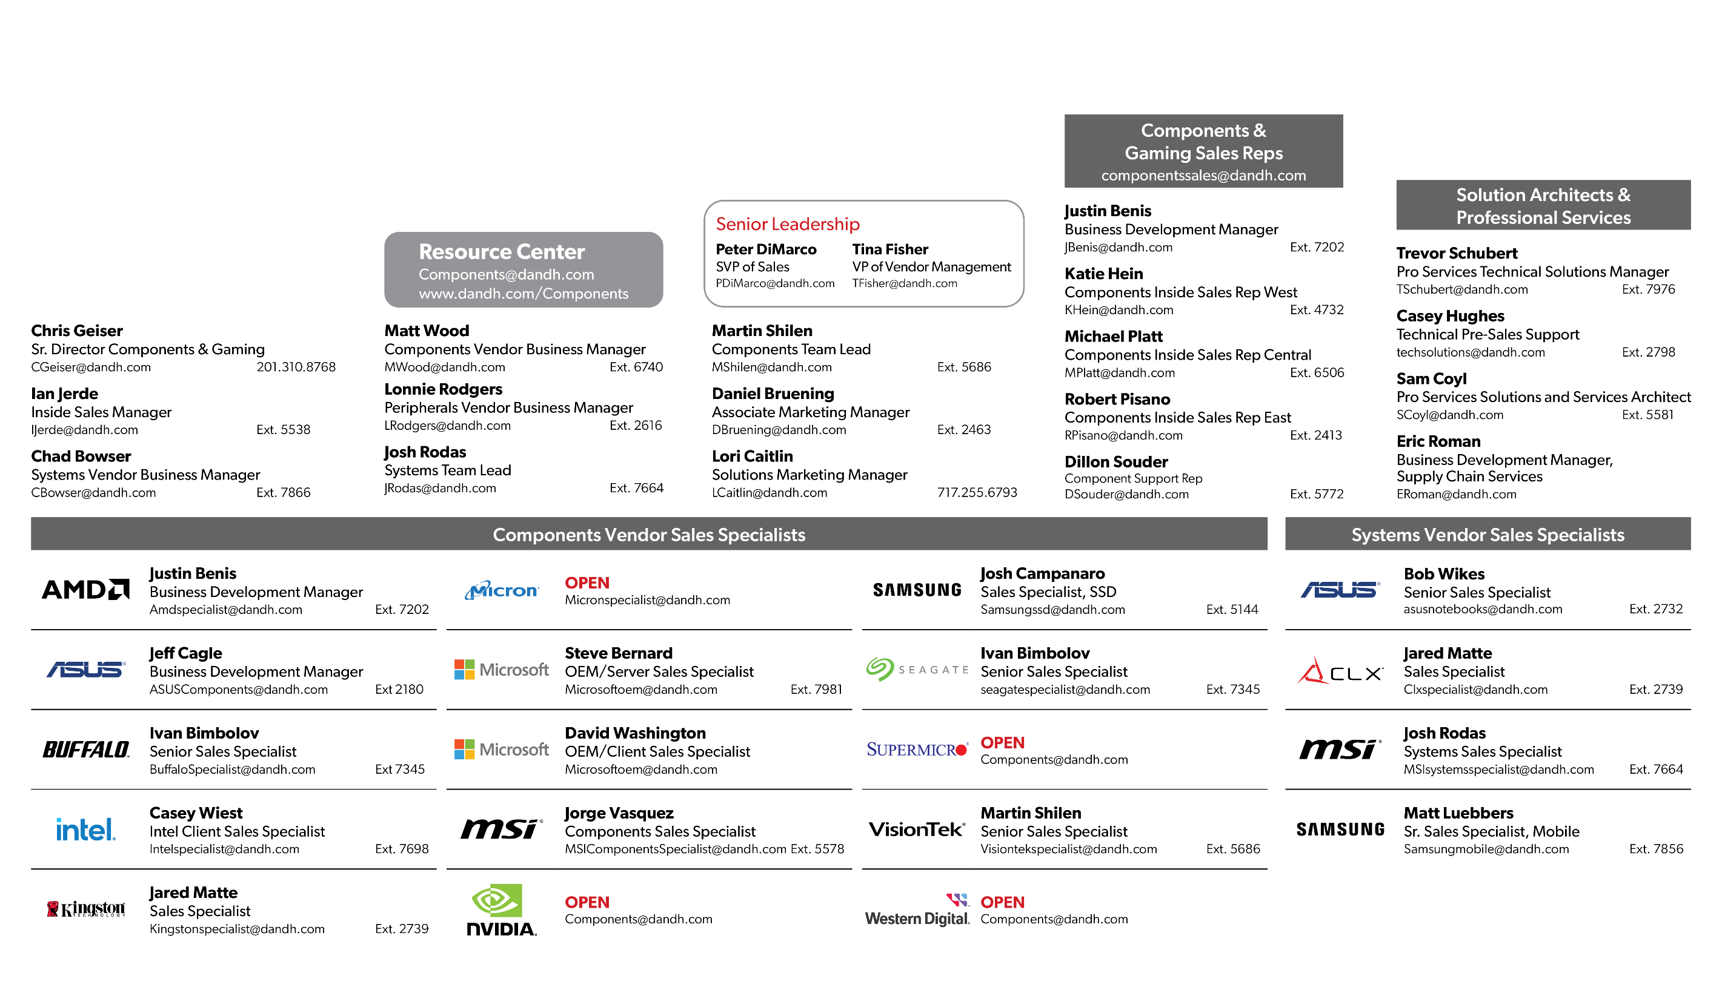
Components/Systems Team

