Slide 1
SIIG
AV over IP Solutions

Slide 2
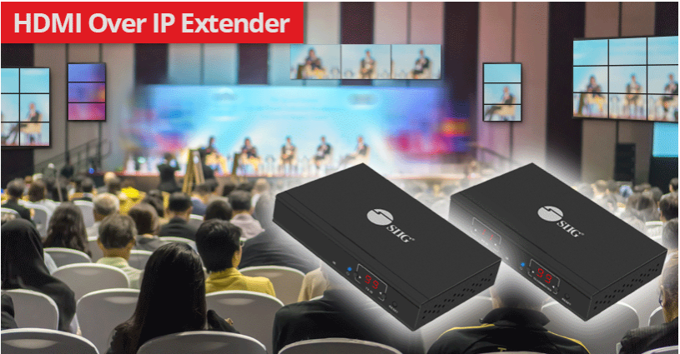
SIIG Product Categories
IT
KVM Switches
Presentation Devices
Docking Stations
Desk Mounts
Power Charging Options
Desktop Add-in Cards
Hard Drive Storage Accessories
Notebook Add-ons
AV
AV Over IP Transmitters and Receivers
Matrix/Switches
Extenders
Splitters
Scalers/Converters
Video/Display Adapters
MST Video Hubs

Slide 3
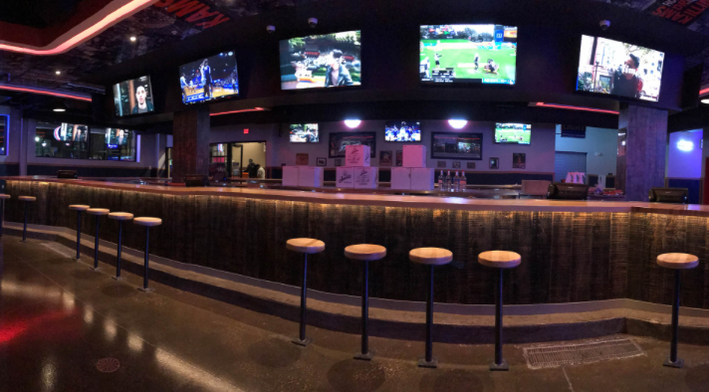
SIIG’s Traditional AV Network Products
AV Categories
Matrix Switches
Distribution Amplifiers
Extenders
Video Wall Controllers
Switches
Scalers/Converters
Video/Display Adapters
Venues:
Sports Bar
Classrooms
Wayfinding
Hospitality Environments
Places of Worship

Slide 4
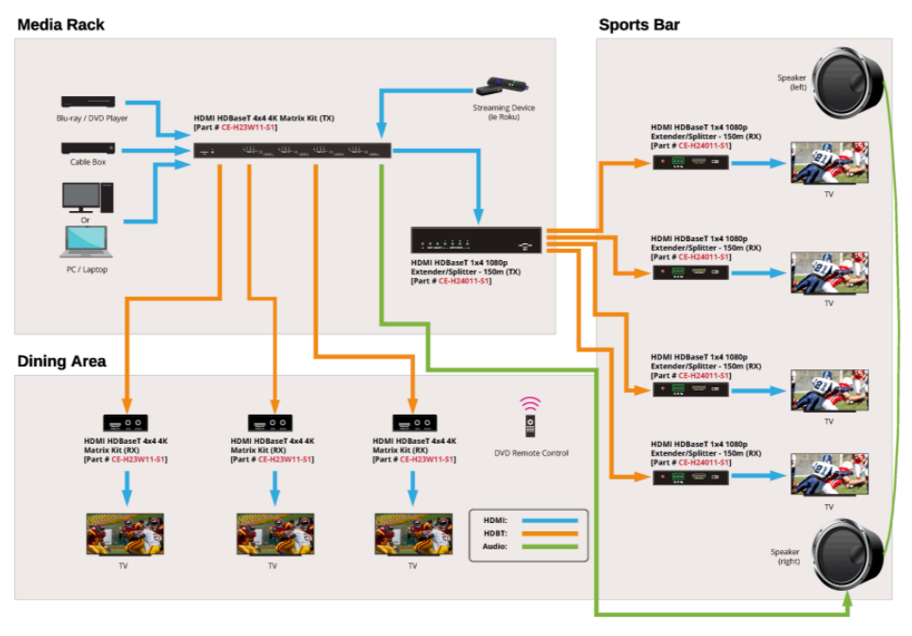
SIIG’s Traditional AV Network
AV Categories
Matrix Switches
Video Wall Controllers
Distribution Amplifiers
Switches
Extenders
Scalers/Converters
Video/Display Adapters

Slide 5
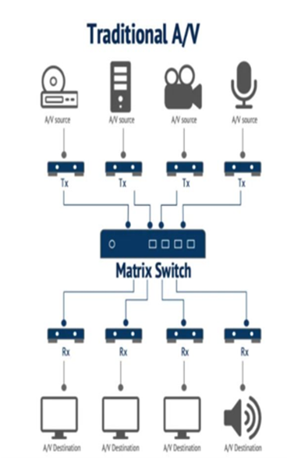
Traditional AV Network
Benefits
Dedicated Network
Does not share its bandwidth over a IP network
Lower Video and Audio Latencies
Higher resolutions and frame rates
Best suited today for smaller AV networks
Constraints
Future Expansion
Can be costly to scale
Matrix Switcher has a fixed number of inputs/outputs
Distance limitations of AV signal
Less cost-effective to implement for medium-size and larger installations

Slide 6
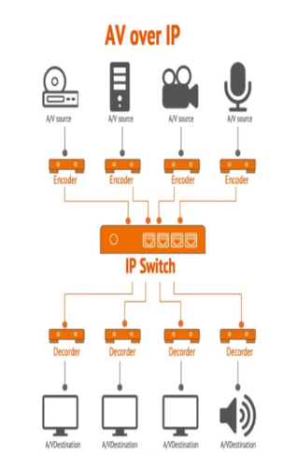
Benefits of AV-over-IP
Transmission of A/V video signals over an IP network
Cost Savings – is a big advantage of an AV over IP setup since it is built on the backbone of an existing IT network, and costs associated with expanding the network are less vs a traditional AV network
Scalability – installation of more transmitters and/or receivers is easily accomplished and cost-effective
Design Flexibility – Future-proof the upgradability of your AV network where additional Transmitters and Receivers can be installed as needed
Content Distance – can be delivered, locally, regionally and even globally,

Slide 7
AV-over-IP – Configuration Types
One-to-Many Topology
Transmitter is connected to multiple Receivers
Single AV signal sent to Many Receivers
Additional receivers available for purchase
Many-to-Many Topology
A number of Transmitters are connected to multiple Receivers
Many AV signals sent to Many Receivers
Additional transmitters and receivers are available for purchase

Slide 8
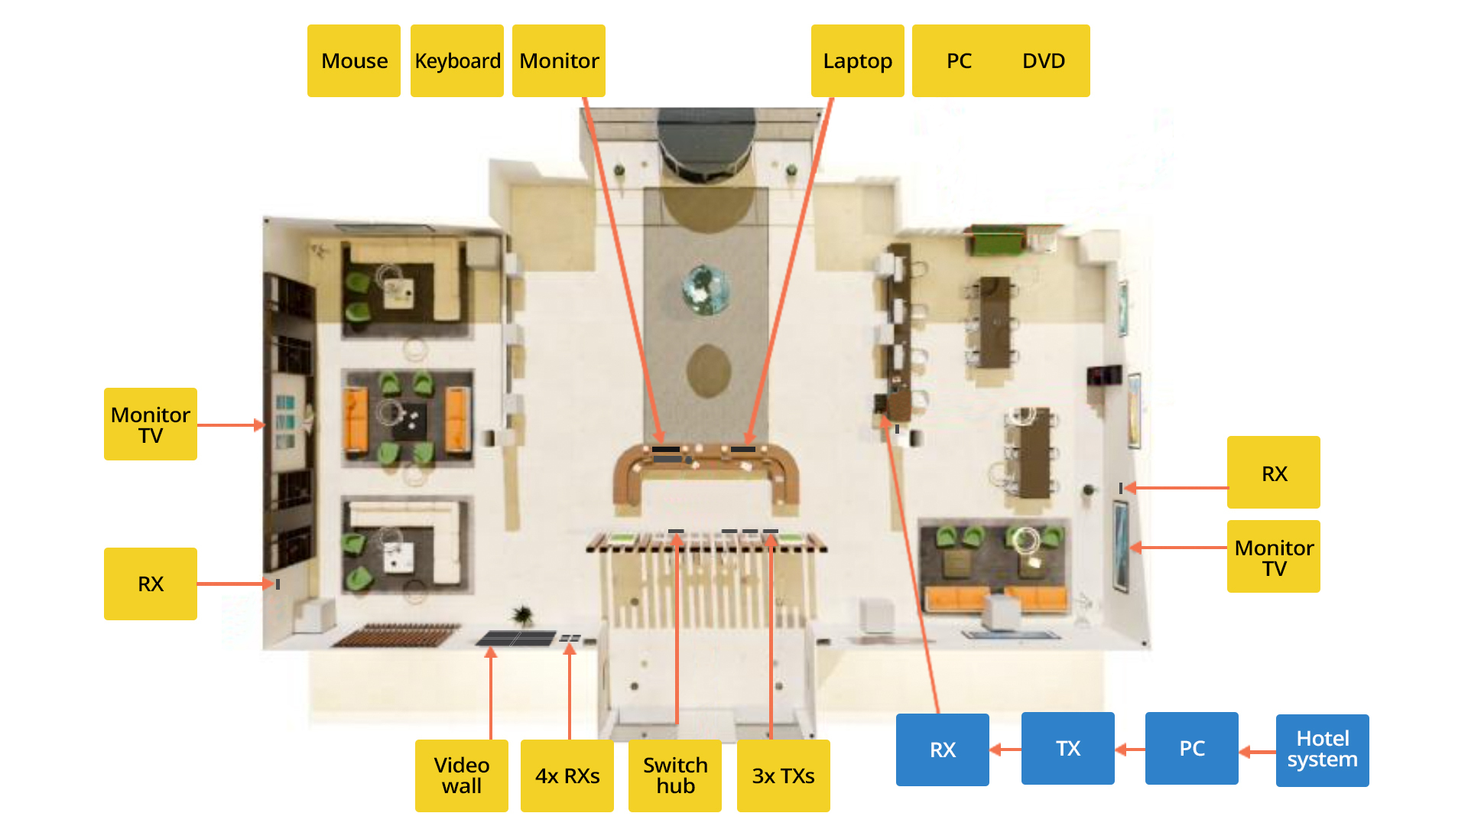
Sample Hotel Lobby Application

Slide 9
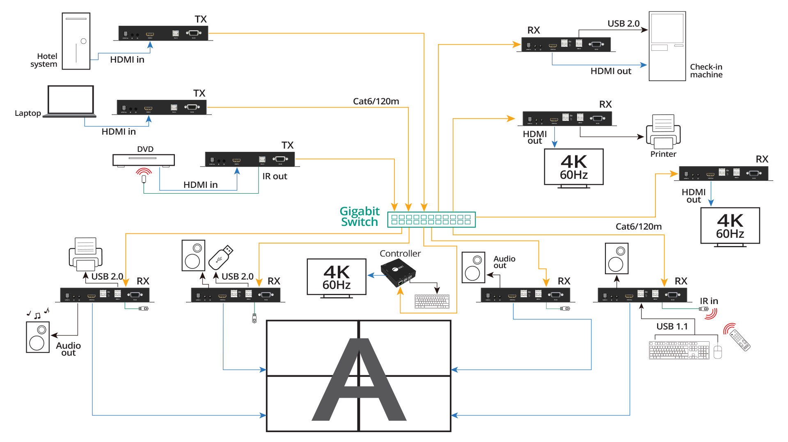
Sample Hotel Lobby Connection Diagram

Slide 10
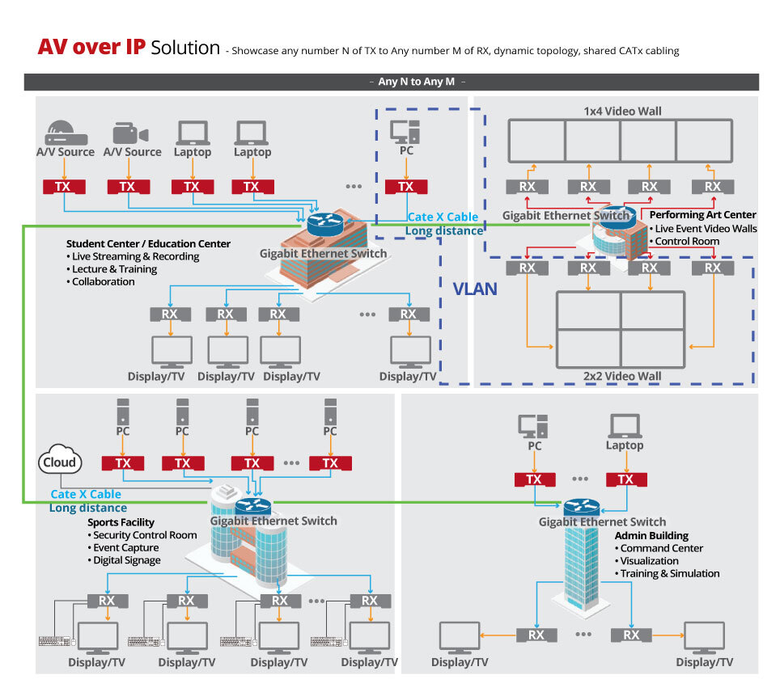
SIIG AV-over-IP Network Products
Student Center
Performing Arts
Sports Facility
Admin Bldg

Slide 11
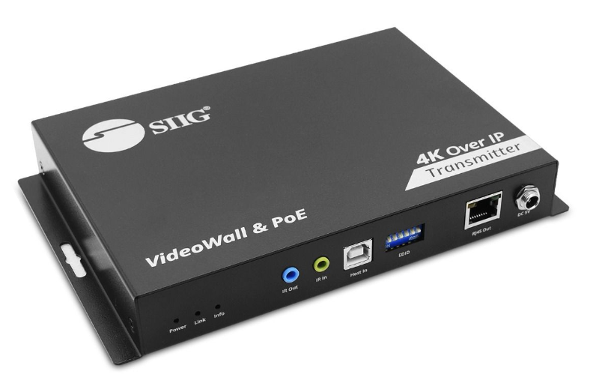
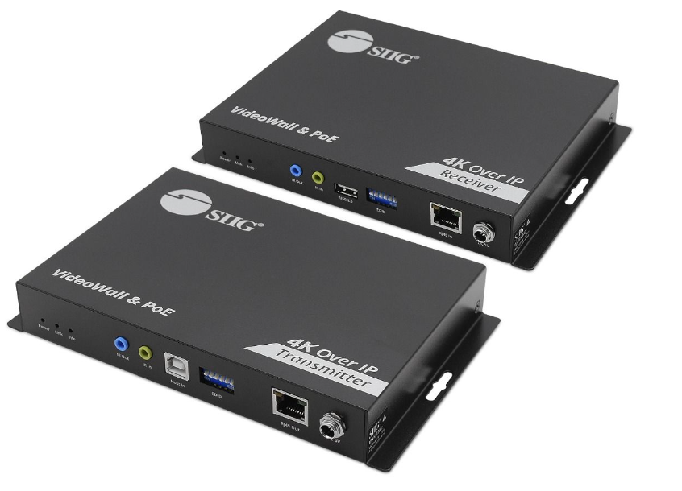
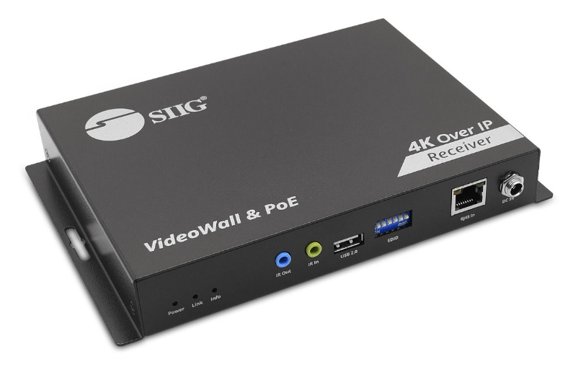
SIIG 4K 60HZ HDMI over IP Solution
CE-H28A11-S1
4K 60Hz HDMI over IP Matrix Kit
SRP $1,099.99
CE-H27F11-S1
4K 60Hz HDMI over IP Matrix Transmitter
SRP $569.99
CE-H27G11-S1
4K 60Hz HDMI over IP Matrix Receiver
SRP $569.99

Slide 12
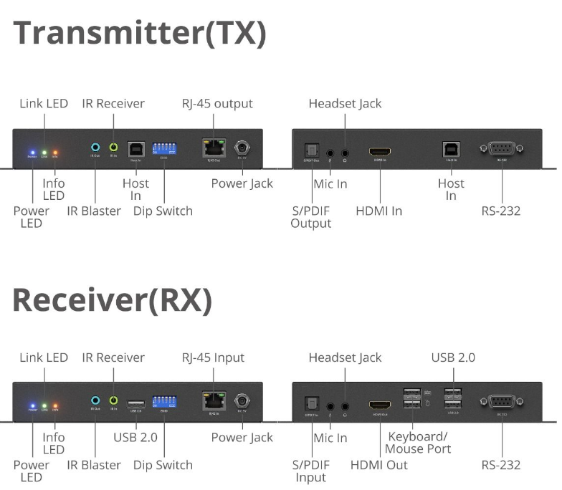
SIIG 4K 60HZ HDMI over IP Solution
CE-H28A11-S1
4K 60Hz HDMI over IP Matrix Kit
SRP $1,099.99
Topology - Many-to-Many
Supports video resolutions up to 4K 60Hz
Supports Power Over Ethernet (POE)
Supports multiple video walls up to a 5X5 per wall each
Supports KVM Extension
Extend HDMI signals up to 394ft up to remote HDMI displays when directly connected
Additional Smart Controller (CE-H25411-S2) enables support of video wall, KVM and ARC functions

Slide 13
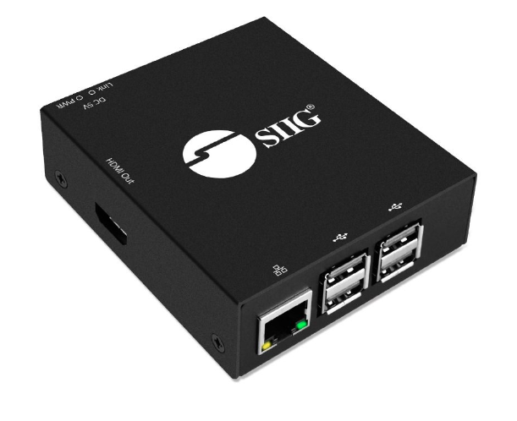
SIIG HDMI Over IP Matrix and Video Wall Controller
CE-H25411-S2
HDMI Over IP Matrix and Video Wall - Controller
SRP $349.99
Pairs with CE-H28A11-S1
Smart Controller and central management system allows real-time monitoring of transmitters and receivers
Easy Installation - auto-detects the transmitter and receiver units on the network
Monitors all devices in one central system
Easy to create multiple video walls. Configurable up to 5x5 display mode
Drag-and-drop easy matrix switching

Slide 16
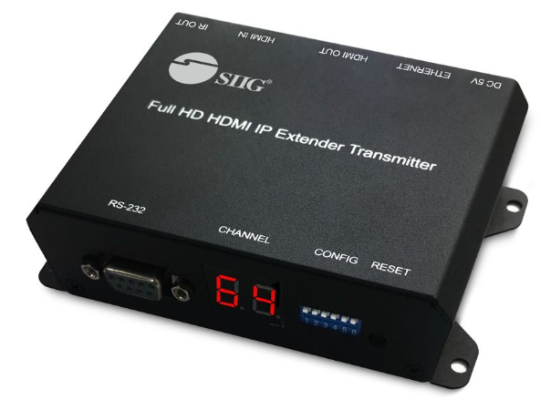
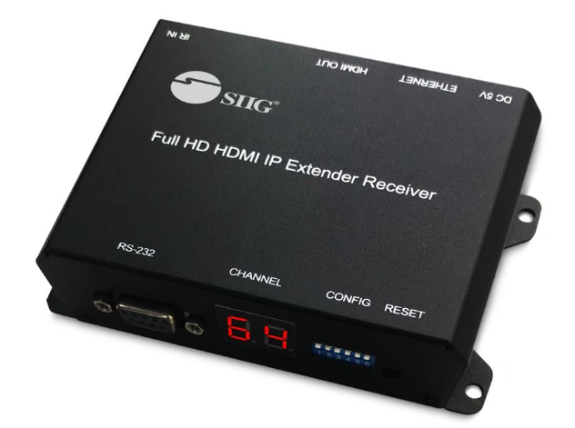
SIIG 1080P HDMI over IP Solution
CE-H26411-S1 - Tx
Full HD HDMI Over IP Extender, PoE, Serial and IR control, 100m
SRP $269.99
CE-H26511-S1 - Rx
Full HD HDMI Over IP Extender, PoE, Serial and IR control, 100m
SRP $269.99

Slide 17
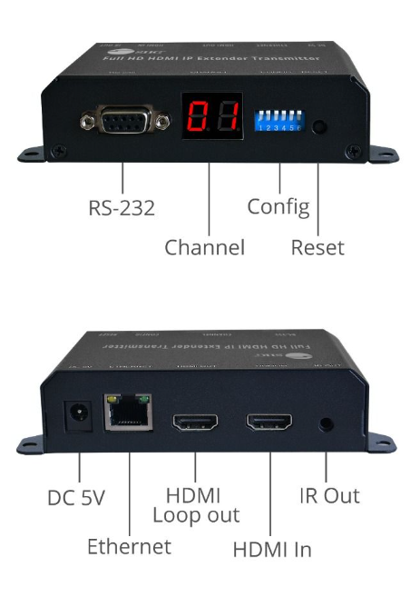
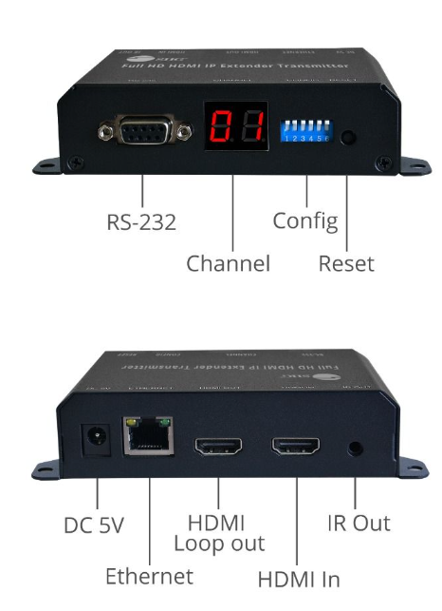
SIIG 1080P HDMI over IP Solution
CE-H26411-S1 - Tx
SRP $269.99
CE-H26511-S1 - Rx
SRP $269.99
Topology - Many-to-Many
Full HD 1080P resolution
Transmits and receives A/V signals up to 330 ft when both Tx and Rx are directly connected
Latency of less than 80ms
Power over Ethernet (POE) enables the transmission of both power and data over a single CAT cable
Additional Tx and Rx units sold separately
Loop Out
IR + RS 232 Extension enables management of source devices from a remote Rx location
TAA Compliant

Slide 18
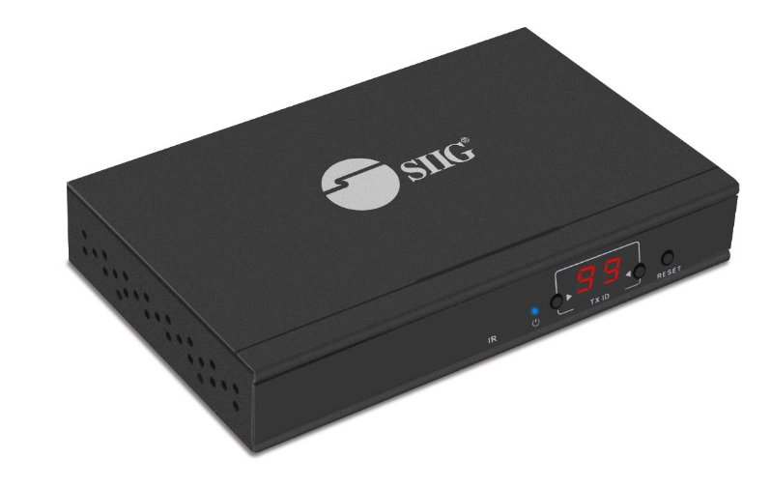
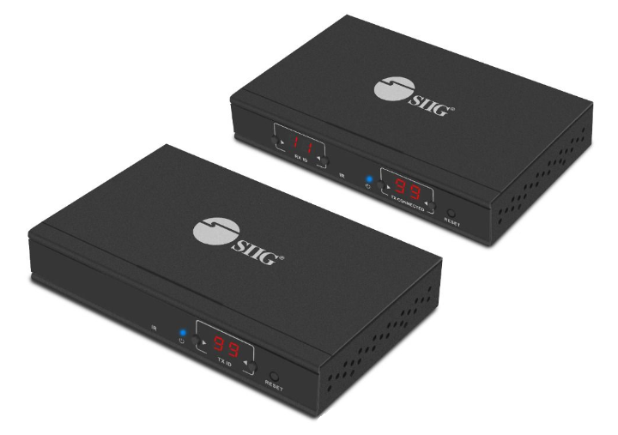
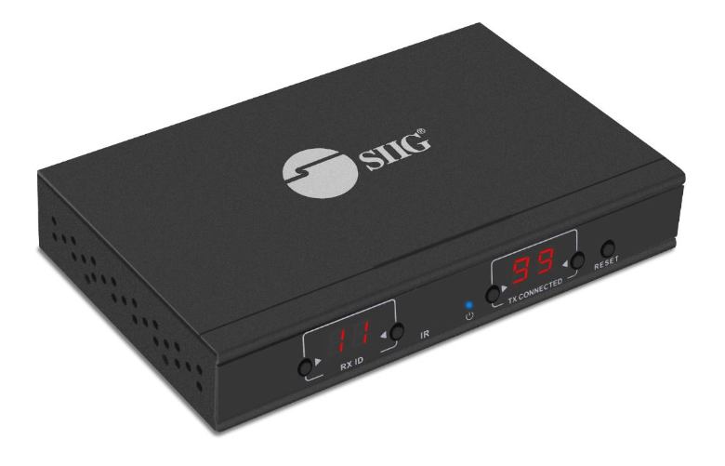
SIIG HDMI Over IP Extender 1080P Solution
CE-H23A11-S2
1080P HDMI Over IP Extender Kit, Serial and IR Control
SRP $319.99
CE-H23B11-S2
1080P HDMI Over IP Extender w IR - Transmitter
SRP $199.99
CE-H23C11-S2
1080P HDMI Over IP Extender w IR - Receiver
SRP $199.99

Slide 19
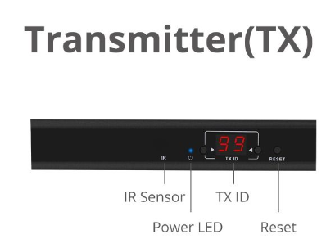
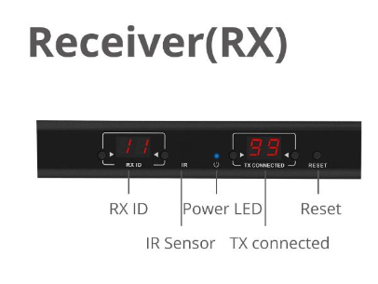
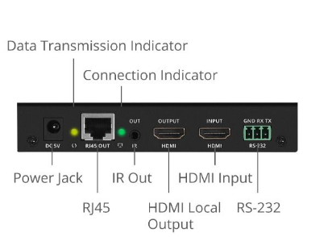
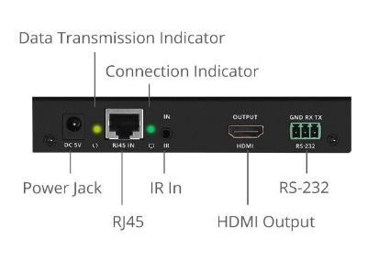
SIIG HDMI Over IP Extender 1080P Solution
CE-H23A11-S2
SRP $269.99
1080P HDMI Over IP Extender Kit, Serial and IR Control – KIT
Topology - Many-to-Many
Transmits and receives 1080P HDMI signals up to 394 ft
Latency of less than 80ms
IR pass-through feature allows remote control of the HDMI source device and playback function at the remote display
Additional Tx and Rx units sold separately
Loop Out
RS 232 support to enable devices in either direction
TAA Compliant

Slide 20
SIIG AVoIP HDMI Transmitters and Receivers Many-to-Many

Slide 21
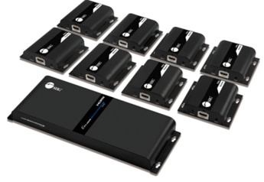
SIIG 1X8 AV-over-IP Distribution Amplifier
CE-H26W11-S1
1x8 HDMI Splitter, Over IP Extender Kit
SRP $779.99

Slide 22
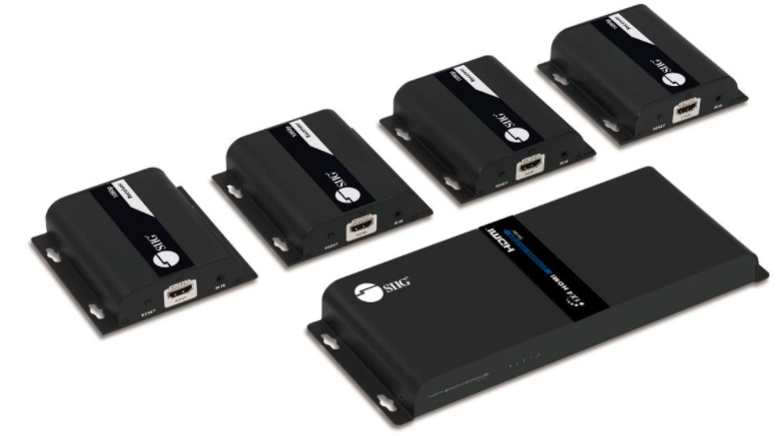
SIIG 1X4 AV-over-IP Distribution Amplifier
CE-H26V11-S1
1x4 HDMI Splitter, Over IP Extender Kit
SRP $559.99

Slide 23
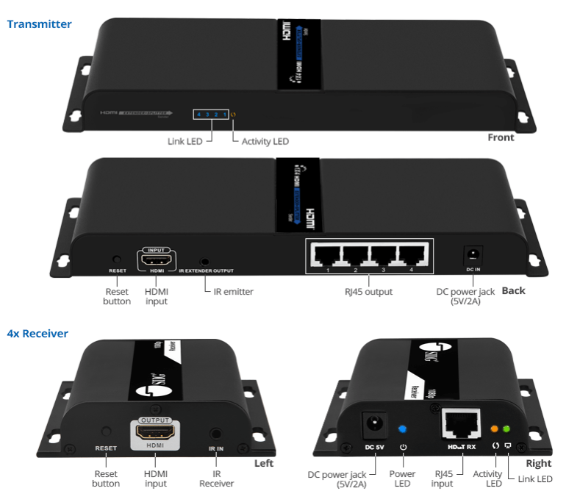
SIIG 1X4 and 1X8 AV-over-IP Distribution Amplifiers
Topology – One-to-Many
Transmits and receives 1080P 60Hz HDMI signals up to 394 ft
Latency of less than 80ms
IR pass-through feature allows remote control of the HDMI source device and playback function at the remote display
Metal Housing
Additional Rx units sold separately

Slide 24
SIIG AVoIP HDMI Transmitters and Receivers One-to-Many

